Slide 1
Immunity
6.1 Defence mechanisms
6.2 Phagocytosis

Slide 2
Learning outcomes
Students should understand the following:
Phagocytosis and the role of lysosomes and lysosomal enzymes in the subsequent destruction of ingested pathogens.
Immune system - barriers - Brainpop.swf

Slide 3
Defence mechanisms
Non-specific
Response is immediate and the same for all pathogens
Specific
Response is slower and specific to each pathogen
Physical barrier
e.g. skin
Phagocytosis
Cell-mediated response
T lymphocytes
Humoral response
B lymphcytes

Slide 4
Recognising your own cells
The body needs to be able to distinguish between its own cells (self) and foreign cells (non-self).
In the fetus the lymphocytes (a type of white blood cell) are constantly colliding almost exclusively with the body’s own material (self).
These lymphocytes are destroyed or suppresses so that the only remaining lymphocytes are those which recognise foreign (non-self) material.

Slide 5
Important points to remember
Specific lymphocytes are not produced in response to an infection they already exist in the body.
Given the high number of lymphocytes (10 million) their is a high probability that one of them will ‘recognise’ the pathogen.
There are only a few of each type of lymphocyte so it takes time for the body to build up the numbers of lymphocytes to destroy the pathogen, hence the time lag between infection and control.

Slide 6
Barriers to disease
Non-specific mechanisms
Epidermis of skin
Layers of dead cells prevent invasion
Mucus membranes
Protective mucus layer secreted by goblet cells. Invaders get trapped in the mucus
Ciliated epithelia
Sweeps invaders away so they can be removed eg in the lung
Hydrochloric acid in stomach
Low pH so the enzymes of pathogens are denatured

Slide 7
Problems with barriers
Some pathogens can penetrate barriers:
Malaria is caused by Plasmodium, which passes through the skin when a mosquito bites
Bubonic plaque enters the skin through flea bites
Influenza virus passes through lining of trachea and lungs

Slide 8
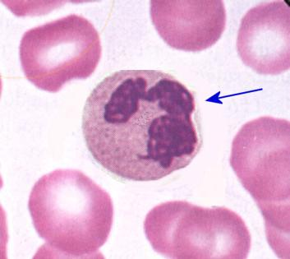
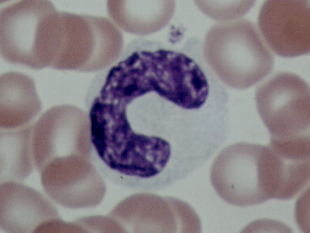
Phagocytosis
Phagocytosis is the process by which pathogens are taken up and destroyed by white blood cells (leucoytes).
These white blood cells are continually produced from stem cells in bone marrow
They are stored in bone marrow and released into the blood to engulf and digest foreign bodies
There are 2 types of phagocytes :
Neutrophils Macrophages
(monocytes)

Slide 9
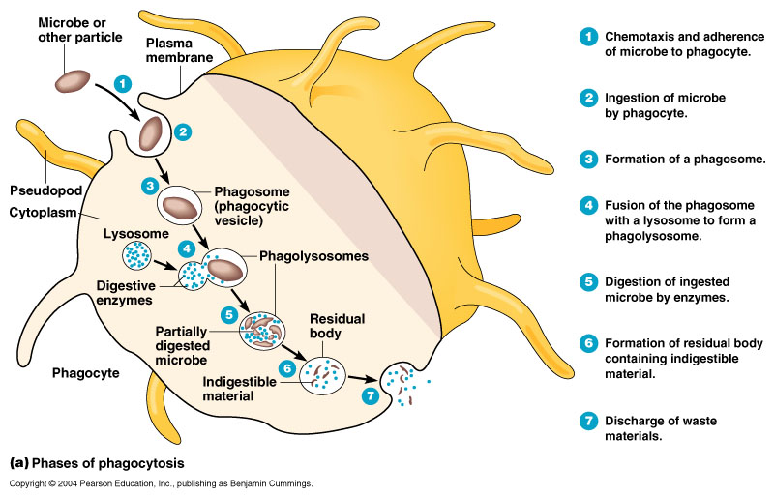
Phagocytosis

Slide 10
Phagocytosis
Phagocytosis causes inflammation at the site of infection.
The swollen area contains dead bacteria and phagocytes, known as pus.
Inflammation is the result of the release of histamine, which causes dilation of the blood vessels in order to speed up the delivery of antibodies and white blood cells to the site of infection.

Slide 11
Learning outcomes
Students should understand the following:
Phagocytosis and the role of lysosomes and lysosomal enzymes in the subsequent destruction of ingested pathogens.

