Slide 1
Immunity
6.3 T cells and cell-mediated immunity

Slide 2
Learning outcomes
Students should understand the following:
The essential difference between humoral and cellular responses as shown by B cells and T cells.

Slide 3
Defence mechanisms
Non-specific
Response is immediate and the same for all pathogens
Specific
Response is slower and specific to each pathogen
Physical barrier
e.g. skin
Phagocytosis
Cell-mediated response
T lymphocytes
Humoral response
B lymphcytes

Slide 4
T lymphocytes
Respond to an organism’s own cells that
have been invaded by non-self (foreign)
material eg a virus or a cancer cell.
They also respond to transplanted material,
which is genetically different.
These cells are called antigen presenting cells because they can present antigens of other cells on their own cell-surface membrane.
This type of response is called
cell-mediated immunity

Slide 5
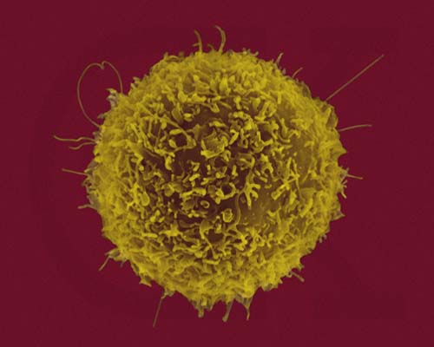
T lymphocytes
T cells are produced in bone marrow and collect in the thymus.
2 main types:
www.med.sc.edu:85/bowers/immune%20cells.htm
T helper cells
T killer cells (T cytotoxic cells)
T cell receptors on membranes have structures similar to antibodies, specific to one antigen.
T suppressor cells – turn off the actions of the various other lymphocytes once the pathogens have been eliminated from the body

Slide 6
Activation of T lymphocytes
Body cell infected by pathogens
Body cell displays antigens from pathogen on its own surface
Mitosis
T killer
T cells stimulated to divide
T cells with appropriate receptors bind to antigens
T helper
Mitosis

Slide 7
T helper lymphocytes
Memory cells
mitosis
Stimulates phagocytes to engulf pathogens
T helper
Cytokine secretion
B lymphocyte division stimulated

Slide 8
T killer lymphocytes
mitosis
Memory cells
T killer
T killer cells produce a protein (perforin) that makes holes in the membrane of an infected body cell and then secretes toxins and enzymes which kill that cell

Slide 9
Cell-mediated immunity
Cellular immune response T cells.swf

Slide 10
Learning outcomes
Students should understand the following:
The essential difference between humoral and cellular responses as shown by B cells and T cells.

