Slide 1
Immunity
6.5 Antibodies

Slide 2
Learning outcomes
Student should be able to understand the following:
Antibody structure and the formation of an antigen-antibody complex
The use of monoclonal antibodies in enabling the targeting of specific substances and cells.
Candidates should be able to
evaluate methodology, evidence and data relating to the use of monoclonal antibodies
discuss ethical issues associated with the use of monoclonal antibodies
explain the role of the scientific community in validating new knowledge about monoclonal antibodies, thus ensuring integrity
discuss the ways in which society uses scientific knowledge relating to monoclonal antibodies to inform decision-making.

Slide 3
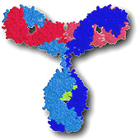
Antibodies
Antibodies are also known as immunoglobulins.
They are proteins synthesised by B lymphocytes.
They are very specific, each antigen has it’s own antibody.
Antibodies have a binding site that fits very precisely onto the antigen to form an antigen-antibody complex.

Slide 4
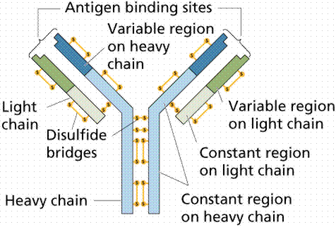
Structure of an antibody

Slide 5
Functions of antibodies

Slide 6
Functions of antibodies

Slide 7
Functions of antibodies

Slide 8
Functions of antibodies

Slide 9
Functions of antibodies

Slide 10
Functions of antibodies

Slide 11
Antibodies
The remarkable specificity of antibodies makes them promising agents for human therapy. But there are problems.
The response of the immune system to any antigen, even the simplest, is polyclonal. That is, the system manufactures antibodies of a great range of structures both in their binding regions as well as in their effector regions.
Even if one were to isolate a single antibody-secreting cell, and place it in culture, it would die out after a few generations because of the limited growth potential of all normal somatic cells.
What is needed is a way to make "monoclonal antibodies"

Slide 12
Monoclonal antibodies
This problem was solved for mice in 1975 with a technique devised by Köhler and Milstein (for which they were awarded a Nobel Prize).
An antibody-secreting B cell, like any other cell, can become cancerous. The unchecked proliferation of such a cell is called a myeloma.
Köhler and Milstein found a way to combine
the unlimited growth potential of myeloma cells with
the predetermined antibody specificity of normal immune spleen cells.
They did this by literally fusing myeloma cells with antibody-secreting cells from an immunized mouse. The technique is called somatic cell hybridization. The result is a hybridoma.
Monoclonal antibodies animation

Slide 13
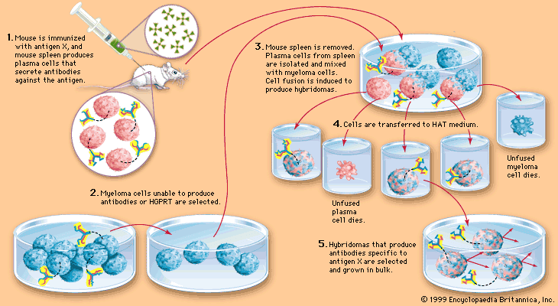

Slide 14
Ethical production and use of monoclonal antibodies
The development of monoclonal antibodies has provided society with the power to treat diseases in a whole new way.
However with this power and opportunity comes great responsibility.
The use of monoclonal antibodies raises some ethical issues

Slide 15
Ethical issues
Production involves the use of mice (to produce antibodies and cancer cells).
To eliminate the need for humanisation of the antibody, transgenic mice can be used (genetic engineering).
There have been some deaths associated with the use of monoclonal antibodies for the treatment of multiple sclerosis.
Testing for the safety of new drugs presents dangers e.g. monoclonal antibody (TGN1412) induced multiple organ failure in 6 healthy volunteers in London in March 2006.

Slide 16
Learning outcomes
Student should be able to understand the following:
Antibody structure and the formation of an antigen-antibody complex
The use of monoclonal antibodies in enabling the targeting of specific substances and cells.
Candidates should be able to
evaluate methodology, evidence and data relating to the use of monoclonal antibodies
discuss ethical issues associated with the use of monoclonal antibodies
explain the role of the scientific community in validating new knowledge about monoclonal antibodies, thus ensuring integrity
discuss the ways in which society uses scientific knowledge relating to monoclonal antibodies to inform decision-making.

