Slide 1
Immunity
6.6 Vaccination

Slide 2
Learning outcomes
Students should understand the following:
The use of vaccines to provide protection for individuals and populations against disease.
Candidates should be able to
evaluate methodology, evidence and data relating to the use of vaccines
discuss ethical issues associated with the use of vaccines
explain the role of the scientific community in validating new knowledge about vaccines, thus ensuring integrity
discuss the ways in which society uses scientific knowledge relating to vaccines to inform decision-making

Slide 3
Types of immunity
Immunity type | How acquired | Duration
Active natural immunity | Immunity develops following natural exposure to antigen | Memory cells develop to produce long-lasting immunity
Active artificial Induced immunity | Immunity develops after immunisation with a vaccine | Memory cells develop to produce long-lasting immunity
Passive natural Immunity | Immunity develops through transfer of antibodies from mother to baby through the placenta and breast milk | No memory cells develop so the immunity is short term and lasts only a few months
Passive artificially induced immunity | Immunity develops after injection with antibodies e.g. tenanus | No memory cells develop so the immunity is short term and lasts only a few months

Slide 4
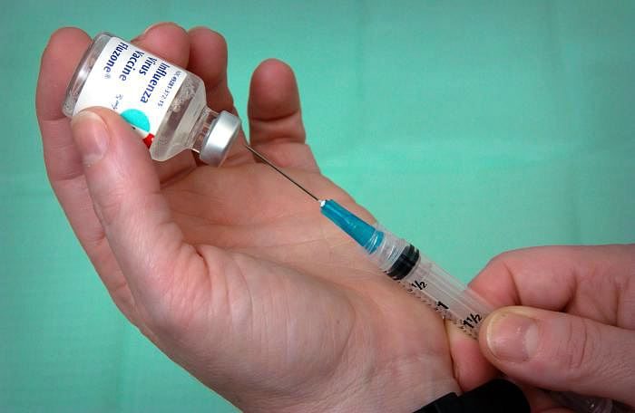
Vaccination
Artificial active immunity – immunity triggered artificially by injection of antigens into the body e.g. vaccination . Types of vaccine:
Living Attenuated Microorganisms
Living, can multiply but no symptoms
Stimulate body’s immune system
More likely to produce side effects
e.g. rubella
Dead (killed) microorganisms
Harmless; induce immunity
e.g. typhoid, cholera, whooping cough
Genetically engineered microorganisms
Antigens from harmful organism transferred to harmless one
Grown in fermenters; antigen purified
e.g. hepatitis B

Slide 5
Vaccination programme in UK
When to immunise | Vaccination given | How vaccination is given | What vaccination protects against
2, 3, and 4 months | Polio Diptheria, Tetanus, Pertussis and Haemophilus Influenza type B (DTP-Hib) Meningitis C | by mouth one injection one injection | Polio Diptheria, Tetanus, Pertussis (whooping cough) and Hib meningitis Meningitis C
12–15 months | Measles Mumps Rubella (MMR) | one injection | Measles, Mumps and Rubella (German measles)
3–5 years | Polio Diptheria, Tetanus and accellular Pertussis (DtaP) Measles, Mumps and Rubella (MMR) | by mouth one injection one injection | Polio Diptheria, Tetanus and Pertussis (whooping cough) Measles, Mumps and Rubella (German measles)
10–14 years (and sometimes shortly after birth) | BCG | skin test, then if needed one injection | Tuberculosis
13–18 years | Tetanus and low dose Diptheria (Td) Polio | one injection by mouth | Tetanus and Diptheria Polio

Slide 6
Successful vaccination programmes
Suitable vaccination that is economically available in sufficient quantities
Few side effects from vaccination
Means of producing, storing and transporting the vaccines
Means of administering the vaccine properly at the appropriate time
Must be possible to vaccinate the vast majority of people e.g. The herd immunity effect

Slide 7
Herd immunity effect
This is the effect of immunising a sufficiently large number of people to protect an entire population from the spread of a particular disease.
The required percentage cover is not the same for every disease and is dependent on factors such as
Population density
Method of transmission
Biology of the disease
Herd effect animation

Slide 8
Problems with vaccines
Vaccination fails to induce immunity in some individuals
Some individuals may develop the disease and reinfect others
The pathogen may mutate frequently e.g. Influenza
So many varieties of a pathogen it is impossible to develop vaccines for them all e.g. common cold
Certain pathogens ‘hide’ from the body’s immune system either concealing themselves in cells or in places that are out of reach (intestines) e.g. cholera
Individuals don’t get vaccinated for numerous reasons e.g. Religious, ethical and medical

Slide 9
Cholera
Control of cholera by vaccination is difficult because:
Cholera is an intestinal disease and therefore not easily reached by the immune system. Any treatment with oral antibiotics are too rapidly flushed away.
The antigens of cholera change rapidly
Mobile populations, resulting from global trade, tourism and refugees spread cholera and make it difficult to ensure that individuals are vaccinated.

Slide 10
TB
Control of TB by vaccination is difficult because:
The increase in HIV infection has lead to more people with impaired immune systems.
Poverty, wars and political unrest have created refugees, who move around a lot and live in over-crowded accommodation
Mobile populations, resulting from global trade, tourism and refugees spread cholera and make it difficult to ensure that individuals are vaccinated.
The proportion of elderly people in the population is increasing. These people often have less effective immune systems and so vaccination is less effective.

Slide 11
MMR vaccine
Is the MMR vaccine linked to autism?
MMR vaccine controversy movieclip

Slide 12
Scientific evidence
All scientific evidence should be initially treated with caution for the following reasons:
Scientific theory should be critically appraised and confirmed by other scientists in the field and this takes time.
Some scientists have vested interests e.g. funding.
Scientists personal beliefs, views and opinion may influence the way they approach the research.
The facts, as presented by media, companies and governments may be biased.
New knowledge may challenge accepted beliefs, theories are being modified all the time.

Slide 13
Homework Ethics of vaccination programmes
Investigate the ethics of vaccination programmes, what questions are raised by the production and use of vaccines?
200 words

Slide 14
Learning outcomes
Students should understand the following:
The use of vaccines to provide protection for individuals and populations against disease.
Candidates should be able to
evaluate methodology, evidence and data relating to the use of vaccines
discuss ethical issues associated with the use of vaccines
explain the role of the scientific community in validating new knowledge about vaccines, thus ensuring integrity
discuss the ways in which society uses scientific knowledge relating to vaccines to inform decision-making

