Slide 1
Variation
7.2 Types of variation

Slide 2
Learning objectives
Students should understand the following:
The need for random sampling, and the importance of chance in contributing to differences between samples.
The concept of normal distribution about a mean. Understanding mean and standard deviation as measures of variation within a sample.
Candidates will not be required to calculate standard deviation in questions on written papers.
Candidates should be able to analyse and interpret data relating to interspeciﬁc and intraspeciﬁc variation.

Slide 3
Sampling
How can we study a whole population?
It’s time consuming and may in truth be impossible.
But we can sample a population and from this sample then draw conclusions about the whole population.
This sample therefore needs to be representative of the population as a whole. How can we achieve this?
Random sampling (non biased - remove the human factor)
Statistical analysis (to ensure observations are not due to chance)

Slide 4
Random Sampling
Looking at buttercups in a field, how could you ensure your sample was totally unbiased and random?
A better form of random sampling is to:
Lay out 2 long tape measures at right angles, along 2 sides of the study area.
Use a random number generator to obtain a series of coordinates.
Place a quadrat at the intersection of each pair of coordinates.

Slide 5
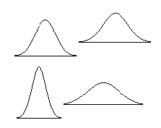
Analysing data
Mean value – tells you about the average of the values collected in a sample.
In a normal distribution of data, most of the samples are close to the mean, with relatively few at the extremes - giving a bell-shaped curve.

Slide 6
Analysing Data
Standard deviation is often used to analyse data sets – it tells you how much a set of data is spread around the mean.
When all the samples have similar values then the distribution curve is steep and the standard deviation is small.
When the samples show a lot of variation, the distribution curve is relatively flat and there is a large standard deviation.

Slide 7
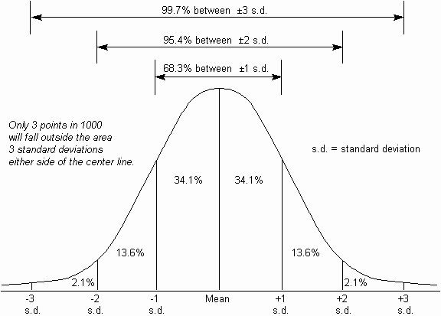
Standard Deviation

Slide 8
Learning objectives
Students should understand the following:
The need for random sampling, and the importance of chance in contributing to differences between samples.
The concept of normal distribution about a mean. Understanding mean and standard deviation as measures of variation within a sample.
Candidates will not be required to calculate standard deviation in questions on written papers.
Candidates should be able to analyse and interpret data relating to interspeciﬁc and intraspeciﬁc variation.

