Slide 1
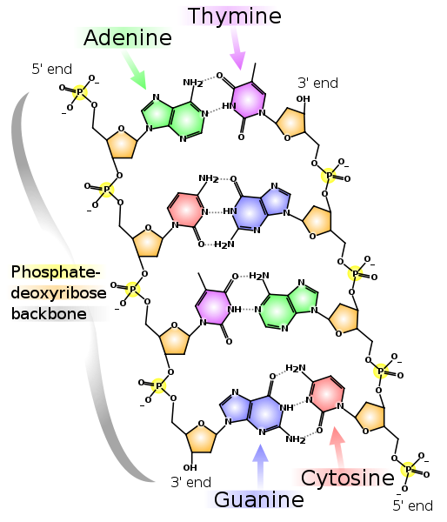
The Structure of DNA

Slide 2
Learning Objectives:
Target E/D:
To learn the basic structure and components of DNA
Target D/C:
To understand how small component molecules are arranged to form nucleotides
Target B/A:
To understand how the resulting nucleotides confer specificity to DNA base pairing due to hydrogen bonds
Success Criteria:
All students:
Complete a diagram of a blank section of DNA
To remember at least 5 molecules mentioned today by the end of the lesson
Target B/A:
To expand and bring in other areas of science into the structure and specificity of DNA

Slide 3
How many biological molecules can you think of?
Molecule | Polymer/Monomer | Process | Origin
All students should be able to fill in at least the first two columns. Students targeted at A and B (and C!) should be aiming to fill in all columns for each molecule they think of.

Slide 4
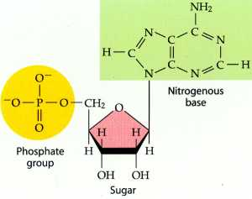
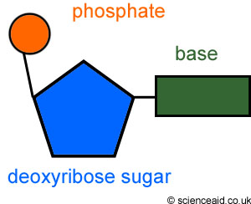
Basic Structure of DNA
DNA is a polymer.
Its monomeric unit is the nucleotide.
Nucleotides link together by condensation reactions between the phosphate group of one nucleotide, and the deoxyribose sugar of another.

Slide 5
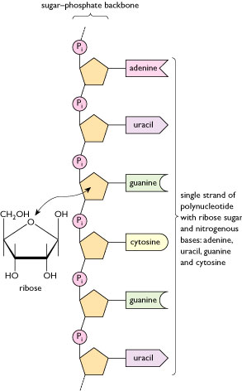
The diagram shows six nucleotides in a chain.
They are linked due to condensation reactions.
Each nucleotide has a nitrogenous base (indicated with different colours and shapes).
This is only a single strand of DNA.
DNA actually exists as a double stranded molecule arranged as a double helix.

Slide 6
DNA diagram

Slide 7
Base Pairing
There are four different nitrogenous bases in DNA.
They form the link between two single strand, which forms a ‘ladder’.
The ladder then folds into a double helix.
The four bases are shown on the diagram.

Slide 8
Specificity
The way in which the four bases link is highly specific.
A base will only form a bond with another base that is complementary.
Above is the only way the bases are able to combine.
What other cases can you think of in biology specificity like this occurs?
Adenine
Thymine
Cytosine
Guanine

Slide 9
In a pair, each student is to come up with a sequence of bases for a single strand of DNA (at least 20 bases long).
Do this on your partners paper and get them to complete the corresponding strand that would make a complete section of DNA.
Check if they have completed it correctly.

