Slide 1
8.2 The Triplet Code

Slide 2
Remembering DNA

Slide 3
How do bases pair together?
Base pairs hold the two strands of the DNA helix together.
The rules for base pairing are…
‘A’ always pairs with ‘T’
‘C’ always pairs with ‘G’
A
T
C
G
There are millions of base pairs in a DNA molecule, and they always follow these rules.
It is the sequence of these bases along a DNA molecule that forms the genetic code – it’s that simple!
Genetic Code Intro.swf

Slide 4
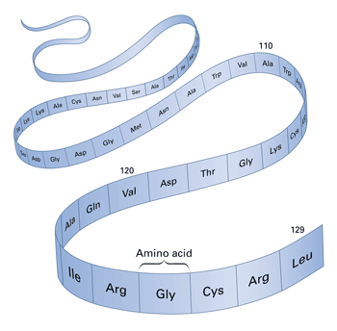
What’s the point of DNA?
It’s a code that gives us the order for a sequence of amino acids.
The amino acids combine by condensation reactions, forming a polypeptide chain.
dna
protein

Slide 5
Location, Location, Location
We know that DNA is compartmentalised in the:
NUCLEUS
We know that proteins are synthesised in the:
CYTOPLASM
DNA can’t leave the nucleus because it’s too large to fit through the nuclear pores.
How does the code contained within DNA get to the cytoplasm where it is needed for protein production?

Slide 6
G
A
nucleus
C
U
C
C
T
G
cytoplasm
A
G
G
A
C
C
U
DNA

Slide 7
Introducing RNA
You’ve just been introduced to a type of RNA.
There are TWO main types of RNA you need to know about at this stage.
In the previous slide, you saw a type of RNA that acted as a messenger.
It transferred the DNA code from the nucleus to the cytoplasm.
Hence, we call it messenger RNA (or mRNA).
mRNA is small enough to leave through the nuclear pores.
mRNA
tRNA

Slide 8
RNA vs. DNA Structure
Just like DNA, RNA is a polymer made up of repeating nucleotide monomers.
RNA however, does not pair up with a corresponding strand. It stays as a single-strand.
The nucleotides that make up RNA and DNA are very similar, but have some subtle differences.
RNA
DNA

Slide 9
Nucleotides in RNA and DNA
DNA
RNA
Phosphate
Phosphate
Organic base
Organic base
Deoxyribose
Ribose
The bases in DNA are:
Guanine (G)
Cytosine (C)
Adenine (A)
Thymine (T)
The bases in DNA are:
Guanine (G)
Cytosine (C)
Adenine (A)
Uracil (U)

Slide 10
mRNA

Slide 11
mRNA
mRNA is produced during the 1st step of protein synthesis (next lesson).
It is formed in the nucleus when a section of DNA unravels, exposing a template for RNA nucleotides to assemble upon.
*mRNA is not identical to the DNA template it has been formed from*.
It is complementary to the template.
mRNA will move to the cytoplasm, where in conjunction with a ribosome, it acts as a scaffold to form proteins on.
The bases on the mRNA indicate the order of amino acids in the protein being made.
C
T
G
A
G

Slide 12
The Triplet Code
Each amino acid in a protein is coded for by a sequence of three nucleotide bases on the mRNA strand.
These sequences of three nucleotide bases are known as CODONS.
The triplet code is referred to as degenerate. – this is because most amino acids have more than one codon.
Eg: UUA, UUG, CUU – all code for leucine
Three codons are stop codons. They mark the end of a polypeptide chain.
C
A
U
A
G
G
C
A
U

Slide 13
The Triplet Code
The code is non-overlapping.
i.e. The mRNA strand below shows three codons in sequence
The code is universal. – The same codon codes for the same amino acid in all organisms.
C
A
U
A
G
G
C
A
U
Histidine
Arginine
Histidine

Slide 14
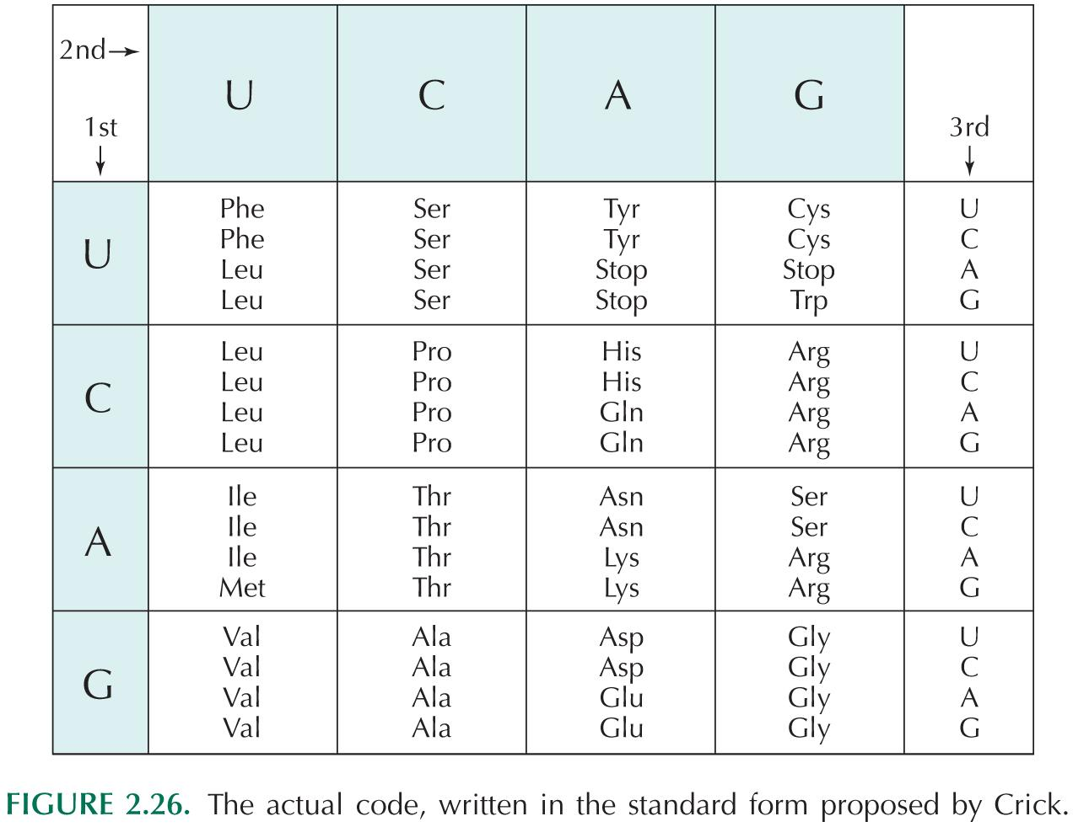

Slide 15
tRNA

Slide 16
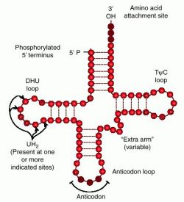
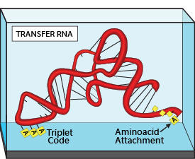
tRNA
Transfer RNA (tRNA) is a small molecule, existing as a single-strand that is folded into a clover-leaf shape.

Slide 17
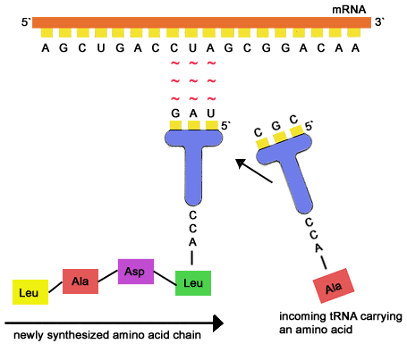
tRNA
The role of tRNA is to bring the amino acids to a ribosome where protein synthesis is taking place. (more on this later)

