Slide 1
Recap of 8.1 and 8.2

Slide 2
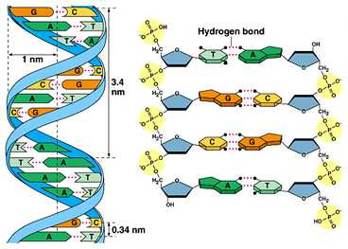
Structure of DNA
Using the diagrams above as visual aids, list as many important facts about DNA structure as you can. There are at least 8.

Slide 3
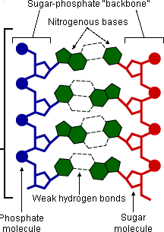
Everybody in the room should be able to name the four indicated bases. You don’t need even a single one to be done for you to begin with. There are just some rules you need to remember...

Slide 4
So how is the structure of DNA linked to its function?
1. DNA is very stable:
It passes from generation to generation without changing.
2. The two strands are linked only by hydrogen bonds:
During DNA replication and protein synthesis, the strands can separate easily.
3. It’s a huge molecule:
It can store vast amounts of information.
4. It’s coiled into a double helix.
The information it carries is protected to a certain extent within the coils of the double helix.

Slide 5
Recap: The Triplet Code
If each single base in DNA coded for an amino acid, how many different amino acids would make up proteins?
Because there are 20 naturally occurring amino acids that make up polypeptides, all life uses the triplet code to code for proteins.
This is where three bases code for a single amino acid.
Using the triplet code gives us 64 codons, which is more than enough codons for the number of amino acids there are.
C G A T C A T G C A T T G G C T T C
G C T A G T A C G T A A C C G A A G
How many amino acids does this section of DNA code for?
Strictly speaking though, can we use the above information to work out the amino acids that are coded for?

Slide 6
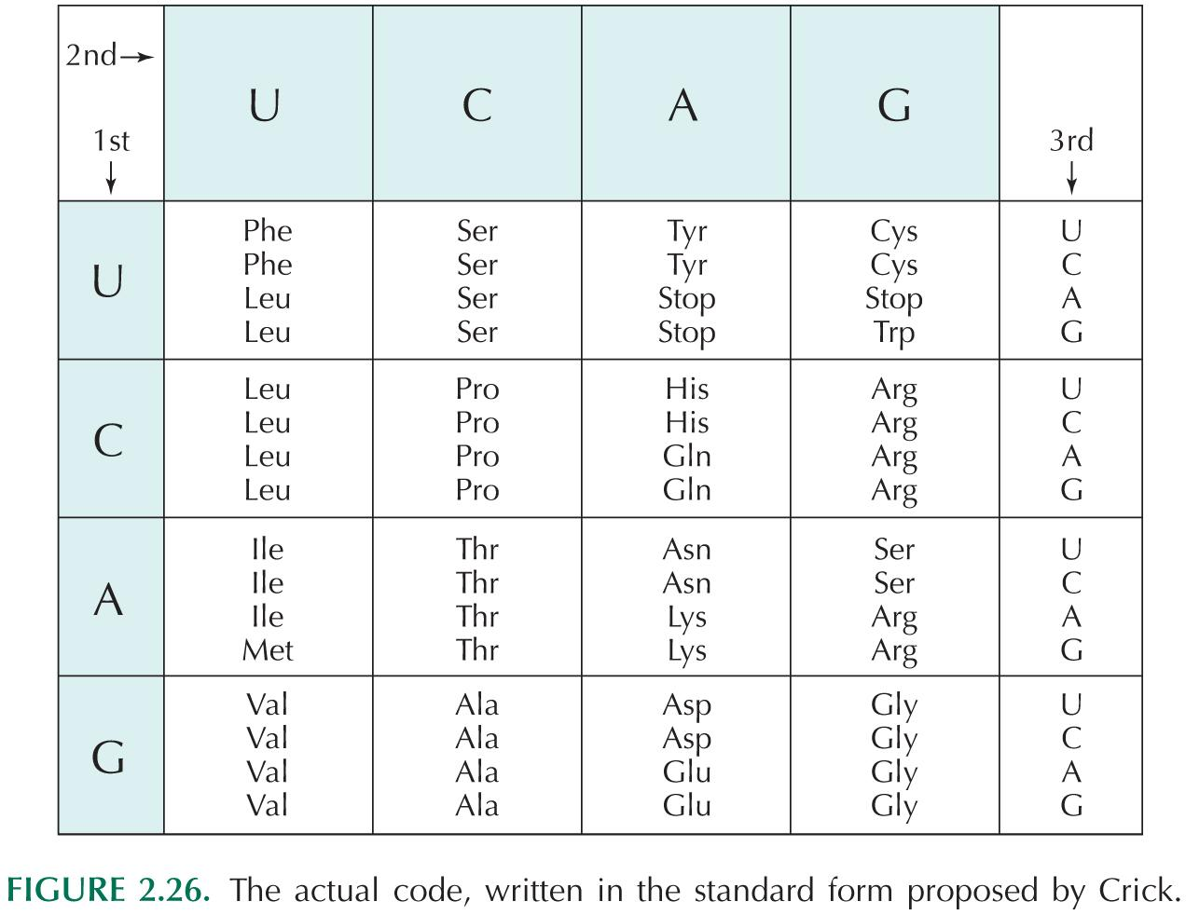

Slide 7
8.3 DNA and chromosomes
Today's Lesson

Slide 8
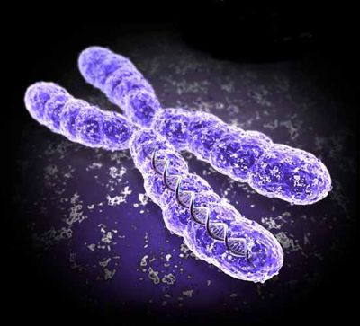
Chromosomes
Now that we know the structure and function of DNA, it’s necessary to determine how it is stored in the nucleus.
Remember that DNA is a massively long molecule. It therefore has to be packed tightly in some way.
In Eukaryotes, DNA is combined with proteins into structures called chromosomes.
It is very important to know that chromosomes only appear for very short periods of time in a cells life.
THE
ANSWER!

Slide 9
Chromosomes
Chromosomes are only visible in their most ‘famous’ form while a cell is dividing.
For most of the time, DNA is in the form of a highly unorganised soup of chromatin.
THE
Only when the DNA is dividing, does it look like the more familiar chromosome that we know.
ANSWER!

Slide 10
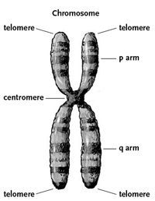
Chromosomes
During the time that they are visible, chromosomes appear as two threads joined tightly together in the middle.
There are some very important features that we need to understand about chromosomes:
They are made of two chromatids.
The chromatids are joined at the centromere.
Chromosomes occur in pairs.

Slide 11
Getting from dna to chromosome

Slide 12
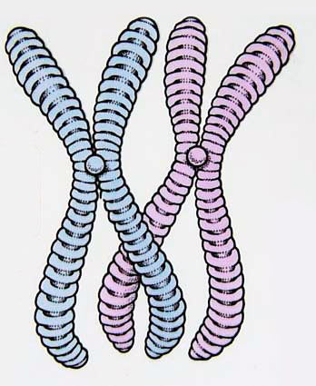
Making Chromosomes
Looking at a chromosome, it is hard to see where DNA actually comes into the picture.
You see no bases. You see no phosphates or deoxyribose sugars. You don’t even see a double helix anywhere.
So what exactly does DNA do to become a chromosome?
WINDING & FOLDING & TWISTING & SNUGGLING UP TO PROTEINS!

Slide 13
Making Chromosomes
You know that DNA is a double helix.
This diagram shows a tiny section of DNA at it’s most detailed level, showing individual bases and coils.
The length of the DNA that makes one chromosome is actually 3 inches! That’s massive compared to the size of the cell it fits into. So something has to be done. The DNA has to be packed somehow.
The first thing to do is to wind the double helix around spherical proteins called HISTONES.
This fixes the position of the DNA and makes sure that a good framework is established to start forming a chromosome.

Slide 14
Making Chromosomes
The DNA-histone complex is then coiled itself, to make it even tighter.
These DNA-histone coils are then looped too!

Slide 15
The whole thing can be shown together like this
Finally, the loops are folded into chromosomes!

Slide 16
Making Chromosomes
You can see that a lot of DNA is condensed into a single chromosome.
You can also see that a single is actually a very, very, long, single molecule of DNA.
This single molecule of DNA has millions of genes along it.
Important:
Chromosomes always occur in pairs!
dad
mum

Slide 17
Homologous pairs of chromosomes

Slide 18
23
23

Slide 19
?
46

