Slide 1
8.4 – Co-dominance & Multiple Alleles
What you should know:
The ‘etiquette’ used to represent genetic crosses.
Know what is, and how to represent a monohybrid cross.
Know what is, and how to represent a cross showing sex-linkage.

Slide 2
Learning Objectives
Learn how co-dominance affects the inheritance of characteristics.
Learn how multiple alleles affect inheritance.
Learn how human blood groups are inherited.

Slide 3
Success Criteria
Be able to show a genetic cross involving co-dominant alleles.
Be able to show a cross involving multiple alleles.

Slide 4
Straightforward situations
In the last couple of lessons, we dealt mainly with simple situations where the alleles were either:
Dominant
Or recessive.
Today’s lesson will focus on more ‘complex’ situations of inheritance, where we will deal with:
Co-dominance
Multiple alleles.

Slide 5
Co-dominance
Co-dominance occurs when two inherited alleles both show dominance to some extent.
That is to say that they are equally dominant.
Sometimes you get a blend of the two characteristics.
In some organisms both characteristics occur in the phenotype.
This means that both alleles are expressed in the phenotype.

Slide 6
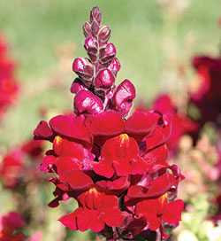
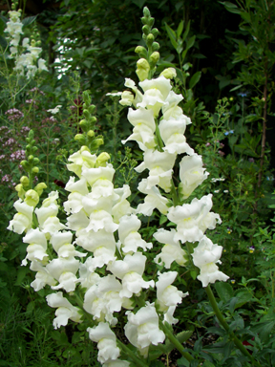
An Example
In snapdragons:
One allele codes for an enzyme that forms a red pigment in flowers.
The other allele codes for an enzyme that lacks the ability to form a pigment, and therefore produces white flowers.
If these alleles showed the usual pattern of one dominant and the other recessive, then there would only be the above two phenotypes.

Slide 7
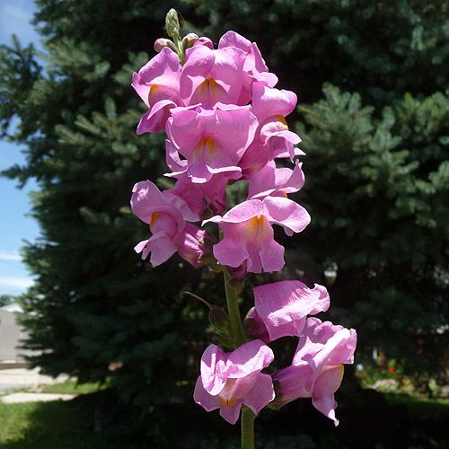
An Example
However, the alleles are co-dominant, so there are three phenotypes:
Which phenotype(s) is/are:
Homozygous for an allele?
Heterozygous for alleles?
and...

Slide 8
Co-dominance Crosses
In crosses showing co-dominance, we can no longer use CAPITAL and lower-case letters to represent our alleles. Why?
Instead, we choose a letter to represent the gene...
And a superscripted letter to represent the allele...
C
C
C
C
R
R
R
W

Slide 9
The Cross
Let:
C^{R} = Allele for red pigment
C^{W} = Allele for no pigment
Parents:
Phenotypes:
Genotypes:
Gametes:
Random Fertilisation:
F₁ Generation:

Slide 10
Multiple Alleles
Sometimes, a gene has more than two alleles – (i.e. It has multiple alleles).
The inheritance of human blood groups is an example.
There are 3 alleles associated with the ‘I’ gene:
The alleles lead to different antigens being produced on the membranes of red blood cells.
Recessive to both A & B
I^{A} I^{B} I^{O}
Co-dominant

Slide 11
Human Blood Groups
Allele I^{A} leads to the production of antigen A.
Allele I^{B} leads to the production of antigen B.
Allele I^{O} leads to the production of neither.
Blood Group | Possible Genotypes
A | I^{A}I^{A or} I^{A}I^{O}
B | I^{B}I^{B or} I^{B}I^{O}
AB | I^{A}I^{B}
O | I^{O}I^{O}

Slide 12
An Example Blood Group Cross
Let:
Parents:
Phenotypes:
Genotypes:
Gametes:
Random Fertilisation:
F₁ Generation:

Slide 13
Multiple Alleles and a Dominance Hierarchy
Multiple alleles sometimes show a dominance hierarchy.
This occurs in cases where there are more than three alleles for a particular gene.
The hierarchy involves alleles that are dominant to those below it.
Read the bottom of page 123 to gain a better understanding.

Slide 14
Learning Objectives
Learn how co-dominance affects the inheritance of characteristics.
Learn how multiple alleles affect inheritance.
Learn how human blood groups are inherited.

Slide 15
Success Criteria
Be able to show a genetic cross involving co-dominant alleles.
Be able to show a cross involving multiple alleles.

