Slide 1
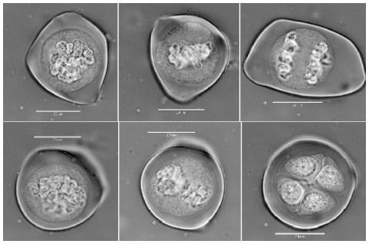
8.4 Meiosis and Genetic Variation

Slide 2
Learning Objectives
To learn why meiosis is necessary.
To understand what happens during meiosis.
To realise how meiosis creates genetic variation.

Slide 3
Passing Information to the Next Generation
Humans are similar because we all have the same genes.
What gives us our quirky differences though, is the inheritance of different alleles to those genes.
Gametes join together at fertilisation to form a zygote.
Gametes always have half the normal amount of DNA in them, compared to regular body cells.
This is so that when two gametes combine, the resulting zygote contains the correct amount of DNA.
How you doin’?
You look like a rat.

Slide 4
Diploid and Haploid
Normal body cells have the normal number of chromosomes
46
We call these cells DIPLOID. It means that each body cell contains two of each chromosome – one from mum and one from dad.
Gametes though, have half the normal number of chromosomes
23
We call these cells HAPLOID. There’s only one copy of each chromosome.
You might see this explained elsewhere as ‘2n’.
And this might be explained as just ‘n’.
At fertilisation, a haploid sperm will fuse with a haploid egg.... which makes a cell with the normal, diploid number of chromosomes ☺

Slide 5
WHADOOSH!
n
n
2n

Slide 6
Gametes are Formed by Meiosis
Meiosis is just a type of cell division. Unlike mitosis though, it’s outcome is insanely different.
Meiosis happens in your reproductive organs.
Ovaries if your a girl...
Testicles if you’re a dude...
But how..........................................................?
Someone draw the outcome of mitosis here:
As you can see by __________’s brilliant drawing, mitosis results in TWO, IDENTICAL DAUGHTER CELLS!
Just like the parent cell, the daughter cells are both diploid too.

Slide 7
Meiosis Involves 2 Nuclear Divisions
It’s easy to explain why meiosis requires two nuclear divisions. You already know that gametes need to be haploid.... 2 divisions will get you from diploid to haploid.
n
Mum
Dad
2n
n
Meiosis I
Meiosis II
2 x 2n
2n
Meiosis begins by just taking a regular, diploid body cell.
n
2n
n

Slide 8
A Quick Summary
Just like any cell in the cell cycle, a regular cell is minding it’s own business as it goes through interphase.
We know that during interphase, a cell with replicate it’s DNA.
Meiosis I then occurs. Homologous pairs are separated, halving the chromosome number.
Meiosis II then occurs. Now, sister chromatids are separated.
Meiosis II is what causes ‘2n’ (diploid) cells to become ‘n’ (haploid) cells.

Slide 9
Remember these words?
Prophase
I
Prophase II
Telophase
meiosis I
meiosis II
I
Metaphase II
Metaphase
I
Anaphase II
Anaphase
I
Telophase II

Slide 10
Meiosis creates genetic variation

Slide 11
Genetic Variation
During all of the amazing things that happen during meiosis, two events in particular, are very interesting.
These two processes create genetic variation during meiosis:
Crossing Over
Independent Segregation of Chromosomes
Crossing over occurs during prophase I.
Basically the two chromosomes in each homologous pair twist around each other.
Wherever they ‘touch’, genetic material is swapped between them.
At the end of crossing over the genetic composition of each c’some is now different
Independent segregation happens in metaphase I.
Basically, when the homologous chromosomes line up, they do so randomly.
This means that when they are pulled apart in anaphase, the combination of chromosomes going into the daughter cells is also random.

Slide 12
Crossing Over
During prophase I, the individual chromosomes of each homologous pair, come into very close contact with each other.
They twist and almost look ‘tangled’.
Wherever the chromatids cross over, is called a chiasma
Now we are ready for the next process that confers genetic variation.... INDEPENDENT SEGREGATION OF CHROMOSOMES...

Slide 13
