Slide 1
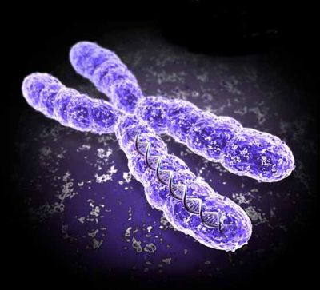
8.1 Studying Inheritance

Slide 2
Lesson Objectives
Distinguish between a genotype and phenotype.
Understand what dominant, recessive and co-dominant alleles are.
Understand what multiple alleles are.

Slide 3
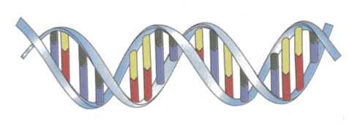
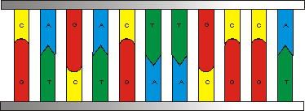
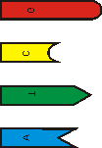
The Structure of DNA
DNA (Deoxyribonucleic acid) a is quite a complicated molecule, but we can simplify its structure by breaking it into blocks.
There are two long sugar phosphate backbones which spiral and intertwine around each other – a double helix!
Joining the spirals, like the rungs of a ladder are 4 different BASES, linked in matching pairs.
Sugar phosphate backbones
Pairs of bases
Flattened out it looks like this:
The 4 bases are given the letters C,G,T and A
G Guanine
C Cytosine
IMPORTANT
Note that: C always pairs with G (with 3 bonds)
T always pairs with A (with 2 bonds)
T Thymine
A Adenine

Slide 4
Chromosomes and Genes
Chromosomes are found in the nucleus of cells. Ordinarily, when a cell is not dividing, chromosome are not visible, and are condensed into a substance called chromatin.

Slide 5
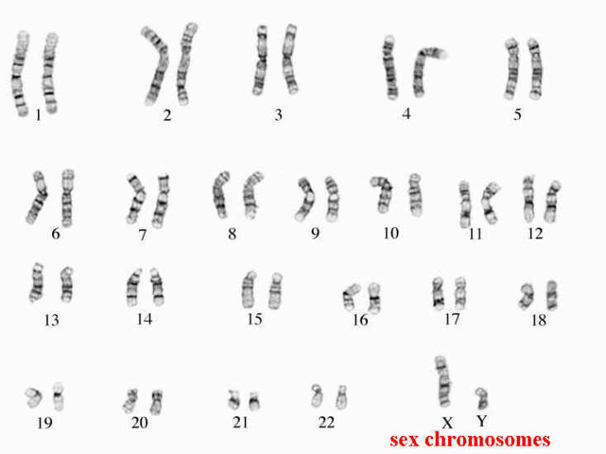
Chromosomes and Genes
Human cells contain 46 chromosomes. There are a couple of exceptions:
1. Gametes – these contain 23 chromosomes.
2. RBC’s – do not contain a nucleus.

Slide 6
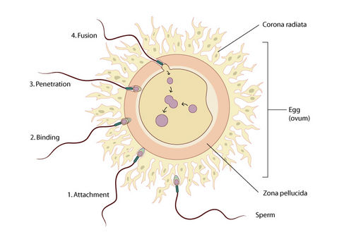
Chromosomes and Genes
During fertilisation, a sperm cells fuses with an egg cell. The fusion of these two gametes results in a zygote, which now has 46 chromosomes.
Therefore, 23 chromosomes are inherited from the mother, and 23 from the father.

Slide 7
Chromosomes and Genes
So the 46 chromosomes inside the cells of your body are actually 23 pairs.
Each pair is known as a HOMOLOGOUS PAIR. As mentioned, one c’some of the pair came from the mother (egg) and the other from the father (sperm).

Slide 8
Genes and Alleles
We know that chromosomes are made of DNA.
Genes are sections of DNA that code for particular proteins, which in turn result in a certain characteristic.
The mechanism that brings about a characteristic from the level of proteins, all the way to a visible feature, is enzymatic.
i.e. All genes code for enzymes which are then involved in a biochemical pathway... Which ultimately leads to every characteristic you see in an organism.
Most genes have an alternative form!

Slide 9
Genes and Alleles
In humans, one of the 23 pairs of chromosomes will of course contain a gene for eye colour.
More than one type of eye colour is present in humans. Therefore, there must be alternative genes that result in different eye colours.
Alternative forms of a particular gene are called:
ALLELES
EG:
Gene for eye colour:
alternative forms: blue
brown ALLELES
green

Slide 10
Genes and Alleles
Now that we understand that different alleles exist for each characteristic, we must look at their positions on chromosomes.
A homologous pair of chromosomes from a fruit fly
R
r
The location of a particular gene on a chromosome is called the LOCUS.
IN HOMOLOGOUS PAIRS, THE GENES/ALLELES FOR THE SAME CHARACTERISTIC ARE FOUND AT THE SAME LOCUS.

Slide 11
Genes and Alleles
The 2 chromosomes of a pair look the same and have the “same genes”* in the same loci.
One from father, one from mother.
The genes shown on these two chromosomes code for eye colour in fruit flies.
They are two different alleles.
R = Red eyes
r = White eyes
R
r

Slide 12
The same allele, or different?
On each of the chromosomes in a homologous pair, the alleles for a particular characteristic can be the same, or different.
In most cases where two different alleles are present in the genotype (heterozygous), only one of them shows itself in the phenotype (the actual organism)

Slide 13
Dominant and Recessive Alleles
Let’s go back to the example of the fruit flies and their eye colour.
There are both alleles for red eyes and white eyes... but flies with this configuration of alleles will ALWAYS have RED eyes. Why?
The fly is a heterozygote for eye colour, and will be born with red eyes, because the allele for red eyes is DOMINANT.
The allele for white eyes in this species is RECESSIVE.
See next slide...
R
r

Slide 14
What eye colours will result with each of these allele configurations?
R
R
R
r
r
r
HOMOZYGOUS
DOMINANT
HETEROZYGOUS
HOMOZYGOUS
RECESSIVE
But is it ever this simple?

Slide 15
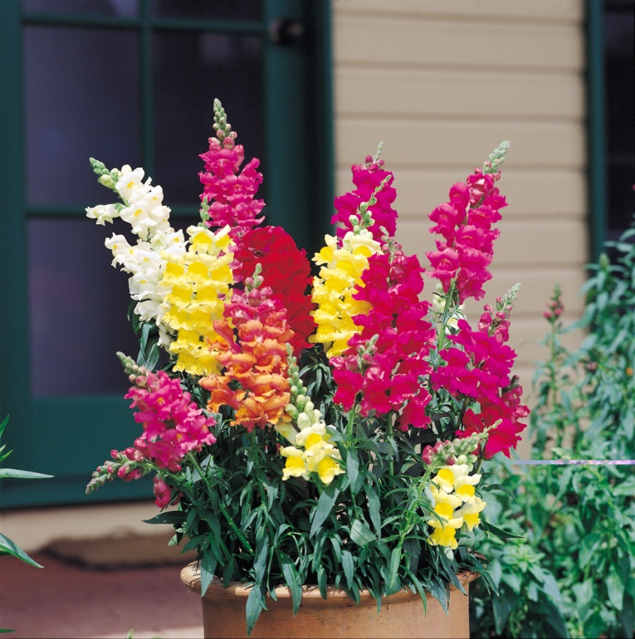
Co-Dominance
Sometimes, two different alleles can both contribute towards the phenotype. In this case, the alleles are called CO-DOMINANT.
When this occurs, the phenotype will be a blend of both features.
Animal coats and flowers exhibit this feature

