Slide 1
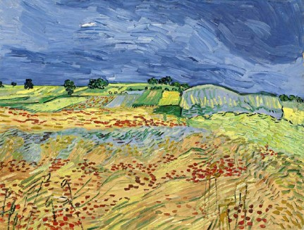
Agricultural Ecosystems
5.4

Slide 2
Learning Objectives
All students should know:
What is an agricultural ecosystem.
How natural and agricultural ecosystems differ.
What is meant by productivity.
How net productivity is calculated.
Specification reference: 3.4.5

Slide 3
Agricultural ecosystems
Energy is transferred through natural ecosystems.
Much of the landscape that we see is not a natural ecosystem but an agricultural one that has been created by humans

Slide 4
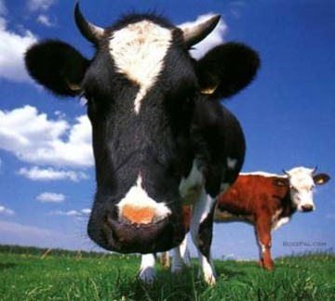
What is an agricultural ecosystem
Made up of largely domesticated animals & plants used to produce food for humans.
Considerable energy losses occur at each trophic level of a food chain.
Humans are usually at the 3rd, or even 4th, trophic level of a food chain.
Agriculture tries to ensure that as much as possible of the Sun’s energy is transferred to humans.
Agriculture channels the energy flowing through a food web into the human food chain and away from other food chains. This increases the productivity of the human food chain.

Slide 5
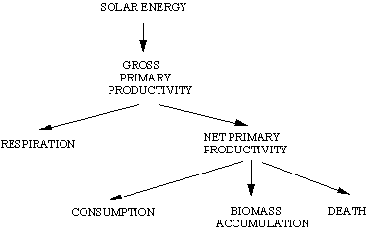
What is productivity?
Productivity is a rate at which something is produced. Producers (green plants) ‘produce’ chemical energy by converting light energy into food e.g. Glucose during photosynthesis.
The rate at which plants assimilate this chemical energy is called gross productivity. It is measured for a given area over a given period of time, usually in units of kJm⁻²year⁻¹ (kJ/m²/year)
Plants use approximately 20% of this chemical energy for respiration. The remainder of the energy is called the net productivity.

Slide 6
Net productivity
Net productivity is expressed as follows:
Net productivity = gross productivity – respiratory losses
Net productivity is important in agricultural ecosystems and is affected by two main factors:
The efficiency of the crop carrying out photosynthesis. This is improved if all the necessary conditions for photosynthesis are supplied
The area of ground covered by the leaves of the crop.

Slide 7
Comparison of natural and agricultural ecosystems
Natural ecosystem | Agricultural ecosystem
Solar energy only – no additional energy input | Solar energy plus energy from food (labour) and fossil fuels (machinery and transport)
Lower productivity | Higher productivity
More species diversity | Less species diversity
More genetic diversity within a species | Less genetic diversity within a species
Nutrients are recycled naturally within the ecosystem with little addition from outside | Natural recycling is more limited and supplemented by the addition of artificial fertilisers
Populations are controlled by natural means such as competition and climate | Populations are controlled by both natural means and by use of pesticides and cultivation
Is a natural climax community | Is an artificial community prevented from reaching its natural climax

Slide 8
Comparison of natural and agricultural ecosystems
The two basic differences are:
Energy input
Productivity

Slide 9
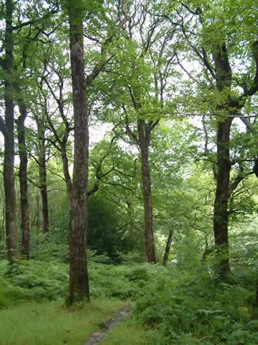
Energy input
The Sun is the only source of energy in natural ecosystems. The climax community of Britain is forest.
We have to prevent this climax community developing in order to maintain an agricultural ecosystem. This is where the majority of species in the community are excluded except the crop being grown.
An additional input of energy is required to remove unwanted species and maximise the growth of the species being farmed. Farmers need energy to plough fields, sow crops, remove weeds, suppress pests and diseases, feed and house animals, transport materials.
The energy comes from:
Food: farm workers expend energy as they work. This energy comes from the food they eat.
Fossil fuels: The mechanisation of farms means energy from fuel is required to plough, harvest and transport crops, to produce and apply fertilisers and pesticides and to transport and feed and livestock.

Slide 10
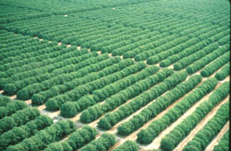
Productivity
Productivity is relatively low in natural ecosystems.
To increase the productivity of a crop, one must reduce the effect of limiting factors on its growth - This requires additional energy!
To reduce competition for carbon dioxide, light, water and minerals required for photosynthesis one must exclude other species and this requires energy.
A monoculture is established
Fertilisers provide essential ions, pesticides destroy pests and prevent disease.
Collectively these factors mean productivity is higher in an agricultural ecosystem then in a natural one.

Slide 11
Plenary
What is meant by the term net productivity?
In what units is net productivity normally measured?
Explain why the productivity of an agricultural ecosystem is greater then that of a natural ecosystem.
What are the differences between the ways that energy is provided in a natural ecosystem and in an agricultural ecosystem?

Slide 12
Answers
Gross productivity minus respiratory losses
kJ m⁻² year⁻¹
In an agricultural ecosystem additional energy is put in to remove other species, add fertilisers and pesticides. These reduce competition for light, water, carbon dioxide etc, provide mineral ions, destroy pests and reduce disease. All these increase photosynthesis and hence productivity.
Natural ecosystems use only solar energy, agricultural ecosystems use additional energy from food (labour) and fossil fuels (machinery and transport).

