Slide 1
Calculating Cell Size

Slide 2
Key Terms
Resolution: the ability to distinguish two separate points as distinct from each other
Magnification: the number of times greater an image is than the object

Slide 3
Practicing magnification maths
There are:
1000 millimetres in a metre (mm)
1 000 000 micrometres in a metre (μm)
1 000 000 000 nanometres in a metre (nm)

Slide 4
How many micrometres are
10mm?
8mm?
17mm?
1cm?
2.5cm?
13cm?
29cm?
14cm?
0.2cm?
1m?

Slide 5
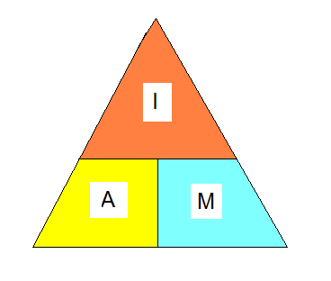
Calculating Actual Size
Actual size = image size
magnification
Magnification = image size
actual size
Worksheet

Slide 6
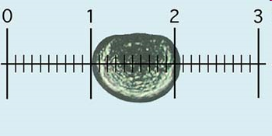
Eye Piece Graticule
Microscopes can be fitted with an EPG
Ruler etched on it
A specimen can be measured in eyepiece units (an arbitrary measurement, the image changes size depending on the magnification, it needs to be calibrated)

Slide 7
Using Stage Micrometer
Place a microscope ruler on a slide (micrometer) on the stage
The ruler is 1mm long and split into 100 divisions
Each division is 10µm (0.01mm)
1µm is equal to 1 millionth of a metre

Slide 8
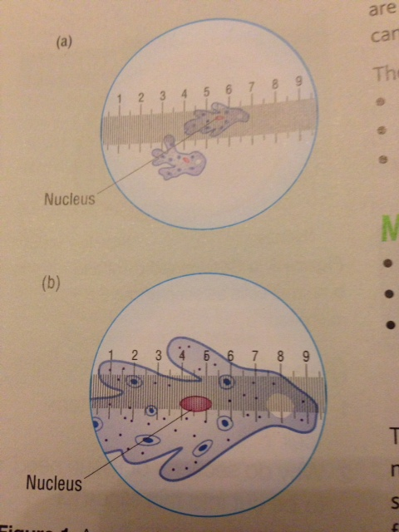
Calculating size
In the image (a), the nucleus is
3.2epu
With x100 mag. 1epu = 10μm
So: the nucleus is 3.2x10 = 32μm
Look at your graticule and stage
Micrometer.
Use them to calculate the size of
an onion cell and a cheek cell.

Slide 9
Plenary Question
If a nucleus measures 100mm on a diagram, with a magnification of x10000, what is the actual size of the nucleus?

