Slide 1
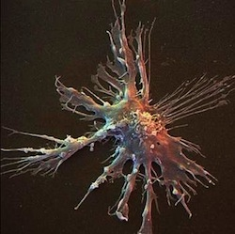
Cells & the Microscope
Lesson 1

Slide 2
1.1.1 Cells & the Microscope
Learning Objectives
Success criteria
Compare the structure and ultra-structure of plant cells with that of animal cells
Compare the structure of different types of cells
Outline the functions of the structures found in cells
Explain the difference between magnification and resolution
Draw accurate diagrams of cells.
Identify that there are several types of cells.
Identify and label organelles from electron microscope pictures.
Demonstrate use of a light microscope
Calculate the magnification of the microscope

Slide 3
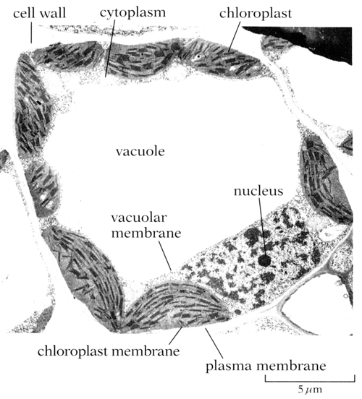
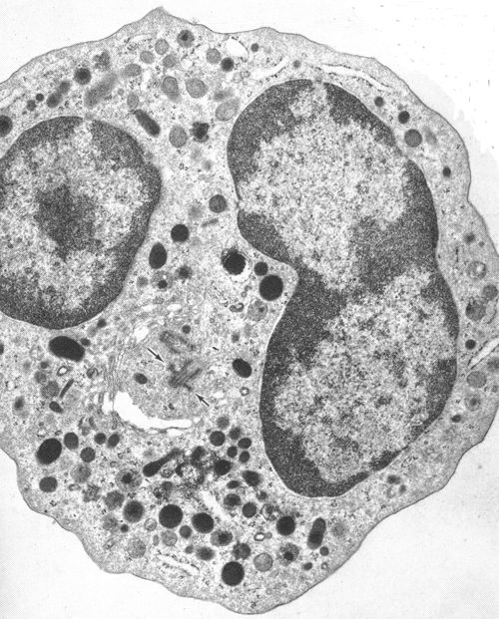
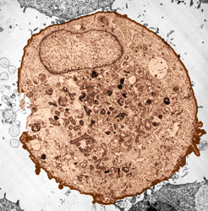
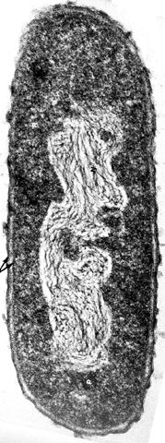
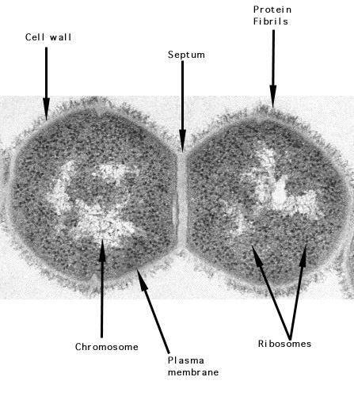
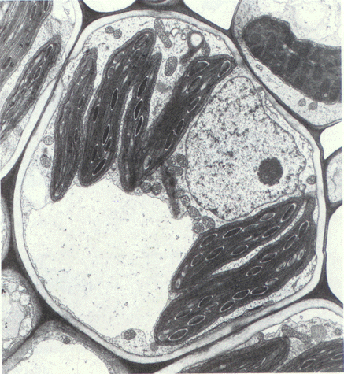
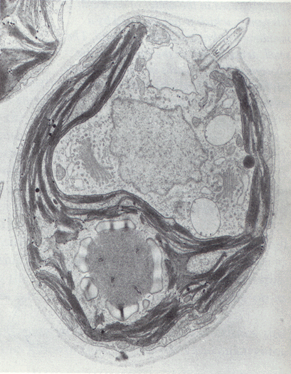

Slide 4
Plant (E)
Animal (E)
prokaryote
Animal (E)
Plant (E)
Proctist (E)
prokaryote

Slide 5
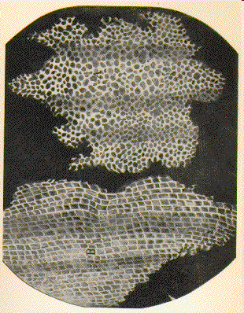
Story of Hooke and Cell Theory
1665 Robert Hooke developed a compound microscope (using several lenses)
He observed structures in cork bark.

Slide 6
Story of Hooke and Cell Theory
1674 Antonie van Leeuwenhoek, first man to see live cells under a microscope (algae Spirogyra)
1830s Henri Dutrochet states ‘The cell is the fundamental element of organization’
1839 Schwann and Schleiden suggested that cells were the basic unit of life
Cell theory was extended in 1855 by Virchow and in 1880 by Weisman

Slide 7
Independent Work
1. Why did Hooke call the structures he observed ‘cells’?
2. Who were the main scientists involved in creating the ‘cell theory’?
3. How can tissue samples be prepared for light microscopy and why do they need to be thin?
Watch the Light Microscope video for some of the answers
http://www.wellcome.ac.uk/Education-resources/Education-and-learning/big-picture/all-issues/the-cell/videos-types-of-microscopy/index.htm
Complete the Cell Theory and Units of Measurements pages of your study booklet (p2-3)

Slide 8
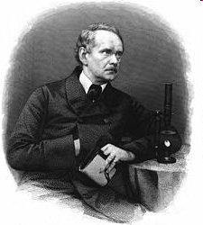
Cell Theory
All living things consist of cells
New cells are formed only by the division of pre-existing cells
The cell contains information that acts as the instructions for growth. This information can be passed to new cells

Slide 9
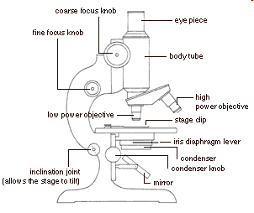
Light Microscope
Uses a number of lenses to view an image through the eye piece
Light passes through the condenser lens and then through the specimen
Beam of light is focused through the objective lens and then through the eye piece lens

Slide 10
Light Microscope
Magnification available on light microscope
x40
x100
x400
x1000
Label Light Microscope Sheet

Slide 11
Key terms
Magnification:
How many times a structure is enlarged
Resolution:
The ability to see two distinct points separately. Objects that are close together can only be distinguished if light waves can pass through them.
Light microscopes have a maximum resolution of 200nm. (ie if they are closer together than that they will be seen as one object)
This is due to the wavelength of light.

Slide 12
Using a Microscope
Demonstration of the use of the microscope (including how to calculate magnification from eyepiece and objective lenses)
or show the video below.
http://www.youtube.com/watch?v=scEhgAiazzU

Slide 13
Microscope Protocol
Examine the microscope and identify the parts as siteing of some controls may vary and some have ‘Fixed’ or specialised condensers.
Rotate the nosepiece to the lowest power objective (x4).
Rack the stage down using the coarse adjustment control and place the specimen slide on the stage using the retaining mechanism to hold in place.
While looking carefully rack the stage up close to the objective lens (do not rack the lens into the slide; this cannot normally occur when a low power objective is selected).
Set the eye pieces to the correct width for your eyes so you can look down both together comfortably..
Look down the eyepieces with both eyes open and slowly lower the stage to bring the specimen into focus, (use the coarse adjustment control initially and then the fine).
Adjust the objective lens to a higher magnification
Adjust the coarse/fine adjustment control slightly to bring the image back into focus

Slide 14
Specimen preparation
Sections of tissue (specimens) to be examined are thin to allow light to penetrate the specimen
Some fragile tissues (eg brain) can be embedded in wax prior to sectioning to prevent distortion of the tissues
Staining are coloured chemicals that allow certain components of a tisue to be seen more easily.
Acetic orcein – Stains DNA red,
Gentian violet stains bacterial cell walls

Slide 15
How small is a cell?
Notes:
Teacher notes
Note that the slider uses a logarithmic scale.

Slide 16
Calculating magnification of images
What is the magnification of what you have drawn?
Next lesson we will look at how to calculate magnification of images under the microscope and images in print
Calculate the magnification of the microscope

