Slide 1
Genetics Revision

Slide 2
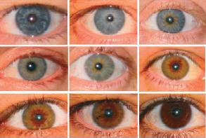
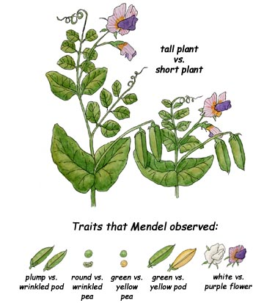
Inheritance
To understand inheritance it is easier to study qualitative traits.
There include traits such as eye and hair colour.
Quantitative traits are more complex and include height and intelligence.
Gregor Mendel studied the inheritance of single characteristics in pea plants.
He was able to control the sexual reproduction of the plants by carefully pollinating them with a brush.
He usually studied two generations at a time.

Slide 3
A typical Mendelian Experiment
P1 (1st Parental Generation)
F1 (1st Filial Generation)
F2 (2nd Filial Generation)
pure-breeding
red flowers
pure-breeding
white flowers
x
all red flowers
(self-cross)
red flowers
white flowers
(75%)
(25%)
Mendel made several conclusions from these experiments...

Slide 4
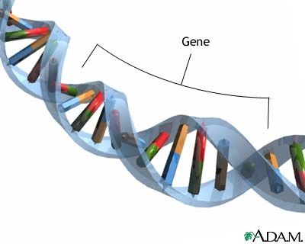
Conclusions
There are no mixed colours.
A characteristic can disappear for a generation.
The outward appearance is not necessarily the same as the inherited factors (i.e. P1 and F1).
One form of a characteristic can mask the other.
When the parents are pure-breeders for two different traits, the F2 ratio is always 3:1.
We now know that Mendel’s experiments were actually showing the inheritance of GENES.
The alternative forms of genes are called ALLELES.

Slide 5
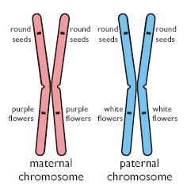
Homologous Chromosomes
We possess two alleles for each gene.
One allele comes from each parent.
Alleles may be either dominant or recessive.
The two copies may either be the same or different...
Genotype Name Phenotype
RR homozygous dominant red
rr homozygous recessive white
Rr, rR heterozygous red

Slide 6
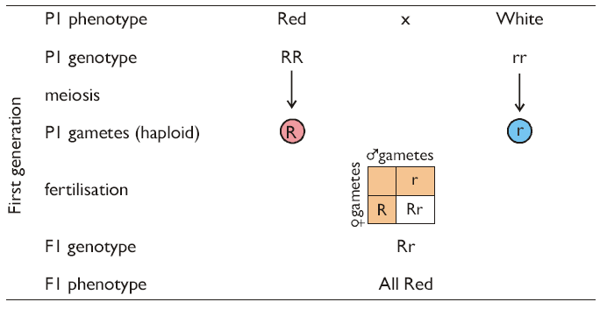
A Monohybrid Cross
A simple breeding experiment involving just a single characteristic, is called a monohybrid cross.

Slide 7
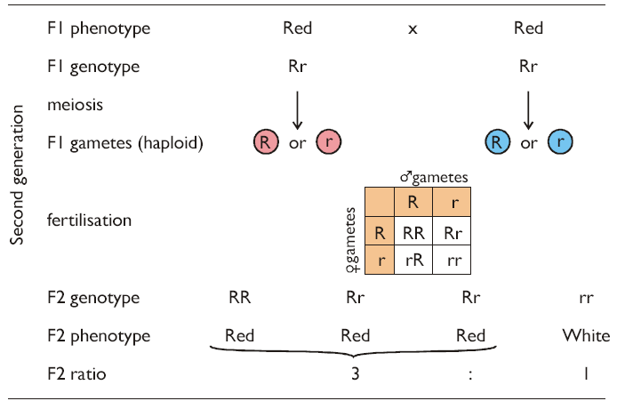
Make sure you understand that although 75% of the phenotypes in this cross are red, they actually have two different genotypes.

Slide 8
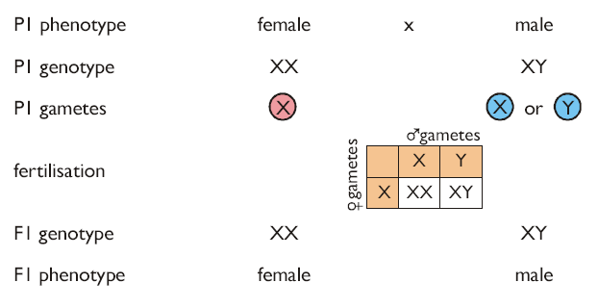
Sex Determination
In humans the 23rd chromosome pair determines sex.
Although sex is determined by the presence of whole chromosomes rather than individual alleles, the inheritance of sex can be shown using a monohybrid cross.

Slide 9
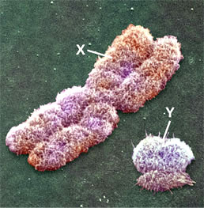
Sex-Linked Characteristics
The Y chromosome is small and does nothing other than determine sex.
The X chromosome is large and contains thousands of genes that have nothing to do with sex.
We call characteristics coded for by genes on the X chromosome:
Sex-linked characteristics
Females have two copies of each gene on the X chromosome.
As males only have one copy of gene on the X chromosome, inheritance of these genes is different in males and females.

Slide 10
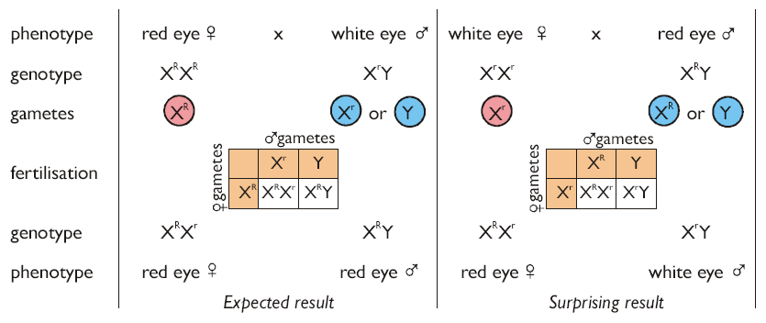
1) Eye Colour In Fruit Flies
The gene for eye colour in Drosophila is found on the X chromosome.
Red eyes (R) are dominant to white eyes (r).
Males always inherit their X chromosome from their mother, and always pass their X chromosome to their daughters.

Slide 11
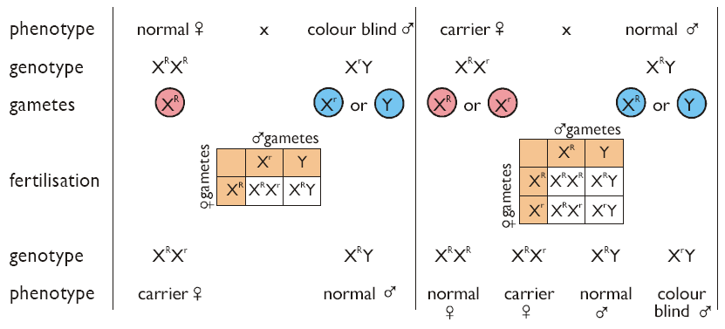
2) Colour-Blindness
8% of males are colour-blind, but only 0.7% of females.
There are three different light-receptor proteins involved in colour vision (red, green and blue).
The genes for green-sensitive and red-sensitive proteins are found on the X chromosome.
Mutations in either gene leads to colour-blindness.

Slide 12
Co-dominance
Sometimes neither allele is completely dominant over the other, the heterozygous genotype has a phenotype of its own.
Since there is no dominance, capital and lower-case letters are replaced by different superscripted letters above gene letters.
An example of co-dominance is flower colour in snapdragons:

Slide 13
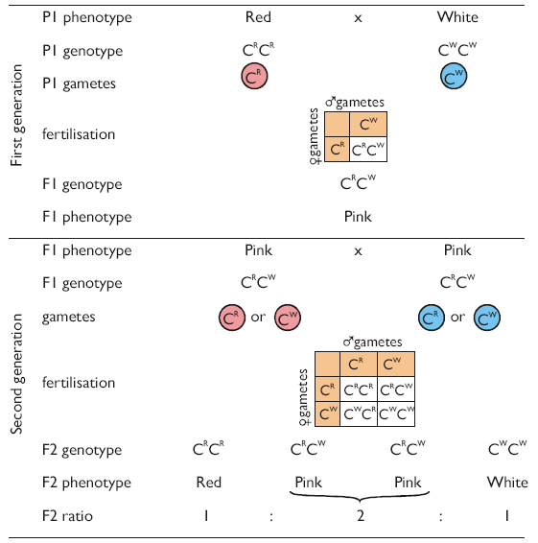

Slide 14
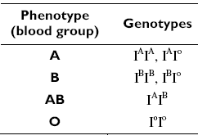
Multiple Alleles
An individual has two copies of each gene, so can only have a maximum of two different alleles of that gene.
However there can be more than two alleles of a gene in a population.
An example is blood groups in humans.
I^{A} and I^{B} are co-dominant.
I^{O} is recessive to both.
This means there are 6 genotypes which result in 4 possible phenotypes.

Slide 15
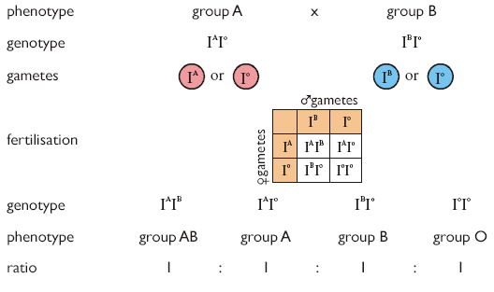
The cross below shows how all 4 phenotypes can be produced from a cross between a group A and group B parent:

