Slide 1
Lesson 10 Smoking – Nicotine and Carbon Monoxide
OCR AS Biology – F212 – Module 2
Food & Health

Slide 2
Learning Objectives
Success Criteria
Understand the effects of nicotine and carbon monoxide on the body.
Understand how nicotine and carbon monoxide may contribute to problems such as atherosclerosis and CHD.
Describe the effect of carbon monoxide on the body (E-D)
Describe the effects of nicotine on the body (D-C)
Explain how atherosclerosis, thrombosis, CHD and stroke occur (B-A)

Slide 3
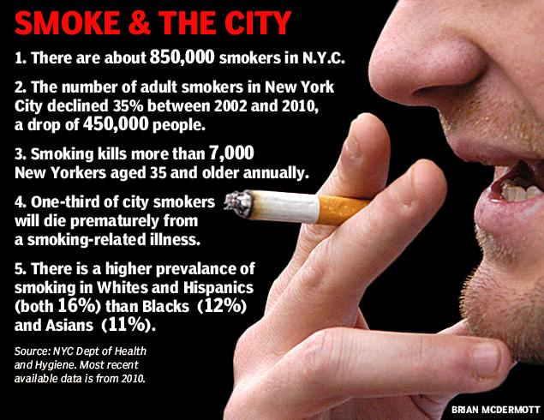

Slide 4
Apart from Tar…
Last lesson focused mainly on the effects of tar in cigarette smoke.
This lesson focuses on nicotine and carbon monoxide
What do you know about them?

Slide 5
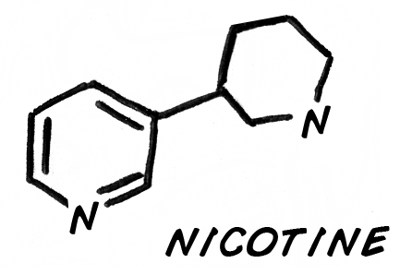
Nicotine
Nicotine is the chemical in ciggie smoke that causes addiction.
Nicotine speeds up the nervous system by mimicking the action of neurotransmitters at the the synapses.
It also causes the release of adrenaline, which increases heart rate, blood pressure and breathing rate.
The body becomes used to the effects of nicotine and no longer feels well unless the person has nicotine in their blood.

Slide 6
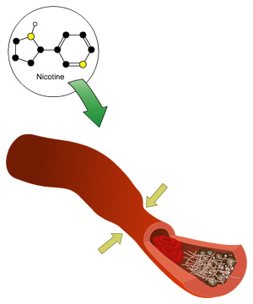
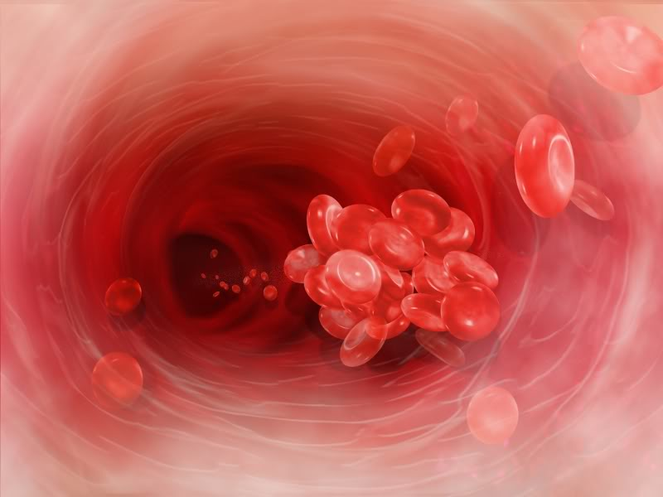
Nicotine
Nicotine reduces blood flow to the extremities by cause arterioles to constrict.
The chemical also causes platelets to become sticky, which means they are likely to clump, and form a thrombus (blood clot).

Slide 7
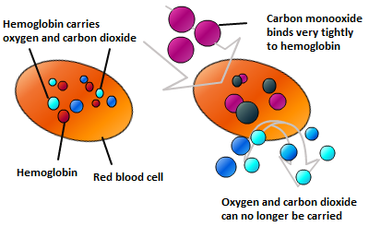
Carbon Monoxide
Carbon monoxide combine with haemoglobin in red blood cells.
This forms an ultra-stable compound called carboxyhaemoglobin.
This reduces the oxygen-carrying capacity of the blood.
Eventually, this will cause the body to detect low levels of oxygen in the blood, resulting in the heart rate going up.

Slide 8
Task:
You may need to finish this as homework….
Create an open-ended table, with the headings below.
Use pages 180-181 (start at the ‘atherosclerosis’ heading) to fill the table in.
Complete the table for atherosclerosis, thrombosis, coronary heart disease and CHD.
One has been started in the table below…
Problem | Cause | Consequence
Atherosclerosis | Carbon monoxide damages lung lining. Damage repaired by white blood cells. Fatty substances deposited, which e | The atheroma eventually forms a plaque, sticking out in to lumen. This reduces diameter of lumen and restricts blood flow.

Slide 9
Plenary Questions
Describe the symptoms of a stroke.
Explain what is meant by a multifactorial disease.
Explain how each of the risk factors may contribute to the chances of a person developing CHD.

Slide 10
Learning Objectives
Success Criteria
Understand the effects of nicotine and carbon monoxide on the body.
Understand how nicotine and carbon monoxide may contribute to problems such as atherosclerosis and CHD.
Describe the effect of carbon monoxide on the body (E-D)
Describe the effects of nicotine on the body (D-C)
Explain how atherosclerosis, thrombosis, CHD and stroke occur (B-A)

