Slide 1
Lesson 1 Nutrition, Diet & CHD
OCR AS Biology – F212 – Module 2
Food & Health

Slide 2
Learning Objectives
Success Criteria
Understand what constitutes a balanced diet.
Understand the importance of various nutrients.
Understand what obesity is.
Link CHD to diet.
Know the difference between HDL and LDL.
Be able to list the 7 components of a balanced diet (E)
Be able to interpret BMI data (D)
Explain how salt, fats and cholesterol increase risk of CHD (C)
Explain how HDL and LDL can increase/decrease risk of CHD (B/A).

Slide 3
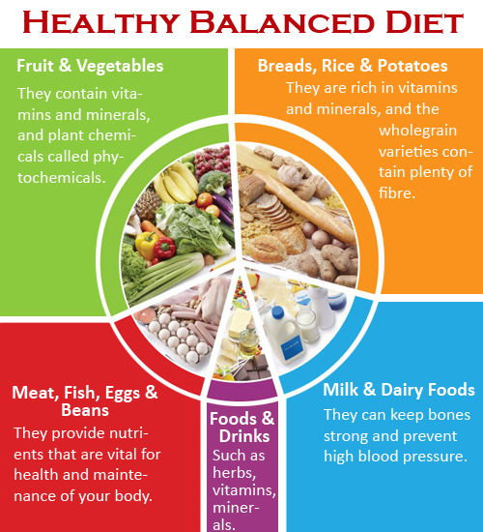
Starter Question
Nutrition comes from the food we eat.
What advantages are gained from eating well?
Better Health
Stronger immune system
Ill less often
Learn more effectively
Make you stronger
Make you more productive.

Slide 4
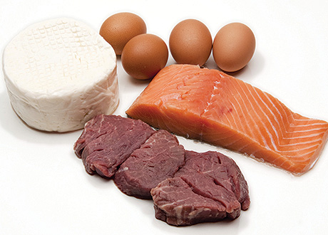
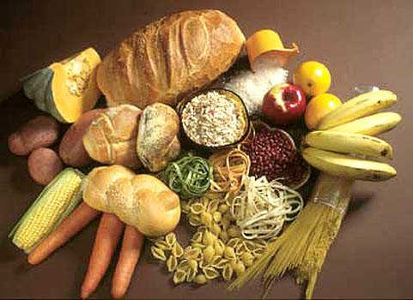
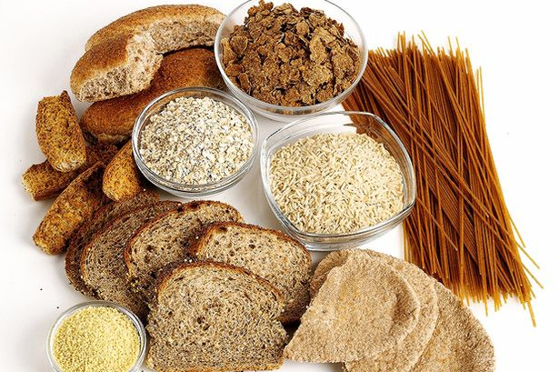
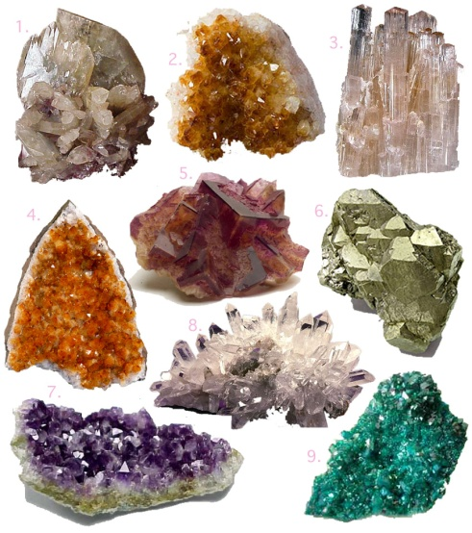
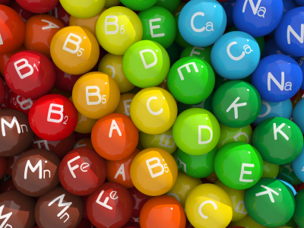
A Balanced Diet...
There are 7 components in a balanced diet.
What are they?

Slide 5
Task
Use Page 152 to create a table to show why each component of a balanced diet is important.
Component | Use
Carbohydrates
Proteins
Fats
Vitamins
Minerals
Water
Fibre

Slide 6
Guideline Daily Amounts
Different people need different amounts of each nutrient.
The Government publishes guideline amounts for each component.
Eg: 17-yr-old girl.
One of the most important aspects of nutrition is
Energy Intake.
Energy requirements depend on a person’s activity levels, gender, mass etc.
Nutrient | Mass/g per day
Carbohydrates | 250
Fats | 80
Proteins | 60
Minerals | 9.2
Fibre | 12
Vitamins | Traces
Water | Variable

Slide 7
Malnutrition & Obesity
Most people think of malnutrition as being a lack of nutrients.
In fact, the biggest type of malnutrition in the developed world is obesity.
BMI | Category
<18.5 | Underweight
18.5 – 24.9 | Acceptable
25 – 29.9 | Overweight
30 – 34.9 | Obese (class 1)
35 – 39.9 | Obese (class 2)
>40 | Morbidly/severely obese (class 3)
A person is classed as obese when their BMI is above 30.
The formula:
BMI = mass (kg)
height² (m)

Slide 8
Exam Practice
Answers
24.7
i – overweight/borderline overweight
ii – very close to border, graph does not distinguish between male and female, does not measure actual fat, has more/less muscle, pregnant (max 2)

Slide 9
Obesity and Health Risks
Obesity is linked to:
Cancer
Coronary Heart Disease (CHD)
Type 2 Diabetes
Gallstones
Osteoarthritis
High Blood Pressure
This is the one we will focus on.
CHD is a degenerative condition
It involves the build-up of fatty tissue in the walls of the arteries that supply the heart muscle.

Slide 10
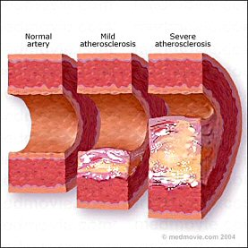
CHD
CHD is the result of the deposition of fatty substances in the walls of coronary arteries.
This deposition is known as artherosclerosis.
The build-up restricts blood flow and can lead to oxygen starvation of heart tissue.
The components of the diet that raise the risk of CHD are:
Salt
Fats
Cholesterol

Slide 11
Task
Read the sections on Page 154 of the textbook, entitled ‘salt’, ‘fats (lipids)’ and ‘cholesterol’.
Summarise the impact of these components in your notes.

Slide 12
Cholesterol
Cholesterol is essential for good health.
It is a type of fat and is transported in the blood in the form of a lipoprotein.
There are 2 types:
High-density lipoprotein (HDL)
Low-density lipoprotein (LDL)
Structure of a lipoprotein:
Phospholipids and protein coat
Centre
Cholesterol
Triglycerides
Other lipids

Slide 13
HDL vs. LDL
HDL’s are a combination of unsaturated fats, cholesterol and protein.
They appear to protect against CHD by removing cholesterol from the tissues, including the tissues in the walls of blood vessels.
Due to this, unsaturated fats are thought to be more beneficial to health.
Now read the section on LDL’s on Page 155.
Compare their effect to that of HDL’s.

Slide 14
Plenary Questions
Explain why it is unhealthy to add salt to every meal.
Explain why a high ratio of HDL to LDL in the blood is considered to be a healthy sign.

