Slide 1
Lesson 2 Food Production
OCR AS Biology – F212 – Module 2
Food & Health

Slide 2
Learning Objectives
Success Criteria
Understand that humans depend on plants for food.
Understand that the process of selective breeding is essential for increased food production.
Understand the use of chemicals in increasing production.
Outline the stages involved in selective breeding (E-D)
Describe how pesticides and antibiotics can be used to increase yield (C-B).

Slide 3
Starter Question
Explain how the following could increase food productivity:
Fertilisers
Pesticides
Fungicide
Antibiotics

Slide 4
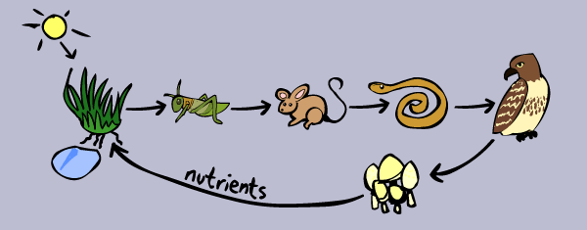
Food Chains
Food chains represent feeding relationships between living organisms
Plants are the basis of all food chains
They are Autotrophs:
Use an external energy source and simple inorganic molecules to make complex organic molecules
This is called photosynthesis.

Slide 5
Define the following:
Producer:
Consumer:
Herbivore:
Carnivore:
Omnivore:
Converts light energy in chemical energy stored within organic molecules.
Consumes another organism in order to obtain energy.
Only consumes plant material.
Consumes other animals.
Consumes both animals and plants regularly. Humans are omnivores.

Slide 6
Food Production
We can increase food production by making food chains more efficient.
Plants
Improve growth rate of crops
Increase yield
Reduce losses due to pests and diseases
Animals
Increase rate of growth
Increase productivity
Increase resistance to disease

Slide 7
Selective Breeding
Video on super-musclely cows:
http://www.youtube.com/watch?v=rW54_vM9SF0

Slide 8
Selective Breeding
Also known as artificial selection.
Humans breed animals with desirable traits.
Over time, the desirable traits were exaggerated.
The purpose of artificial selection is to increase the benefit to humans.
Stages to Selective Breeding:
Isolation
Artificial selection
Inbreeding

Slide 9
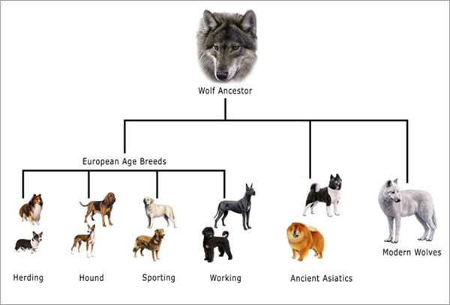
The domestication and selective breeding of wolves...

Slide 10
Selective Breeding in Animals
Food production has been vastly increased due to the selective breeding of animals.
There have been massive increases in the yield of meat, milk and eggs.
Faster growing breeds:
Farmed salmon:
reduce time to market
Production of lean (low fat) meat.
Egg laying chickens can lay up to 300 eggs per year.

Slide 11
Selective Breeding in Plants
Examples:
Tomatoes
Bred with improved disease resistance
Apples
Varieties with improved texture and flavour
Better quality
Nutritional value
flavour

Slide 12
Using Chemicals to Increase Food Production
Use page 157 to answer the following questions:
Plants require minerals for growth. What can be added to soil, and what minerals does this substance provide?
Give at least two examples of the use of pesticides to increase food production.
Intensively reared livestock are kept very close to each other. There is often spread of disease. How is this prevented?
ANSWER IN FULL SENTENCES

Slide 13
Plenary Questions
Explain the difference between natural selection and artificial selection.
How does the application of a pesticide improve the yield of a crop such as wheat?

