Slide 1
Lesson 3 Microorganisms & Food
OCR AS Biology – F212 – Module 2
Food & Health

Slide 2
Learning Objectives
Success Criteria
Understand that food spoilage can be harmful to human health.
Understand the methods used to prevent food spoilage.
Understand how microorganisms can be used to make food.
Discuss the advantages and disadvantages of using microorganisms.
Recall the ways in which food spoilage can be seen (E-D)
Describe the ways in which food spoilage can be prevented (C-B).
Explain how microorganisms can be used to make food and the advantages/disadvantages of this (A-A*)

Slide 3
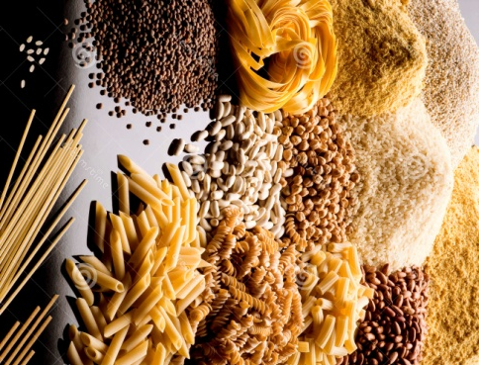
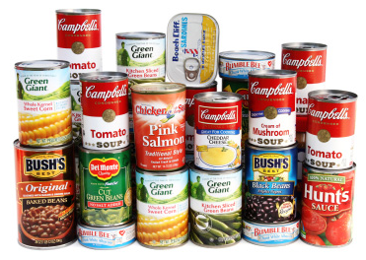
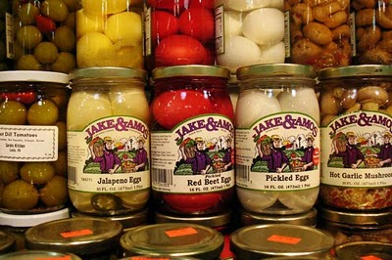
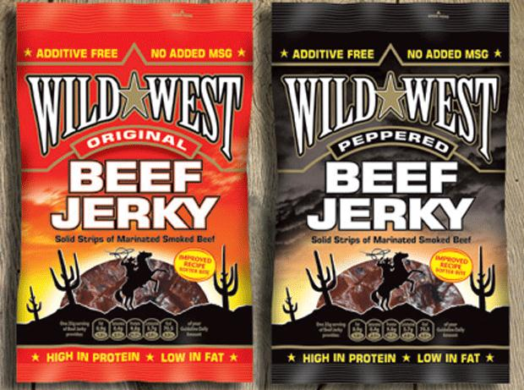
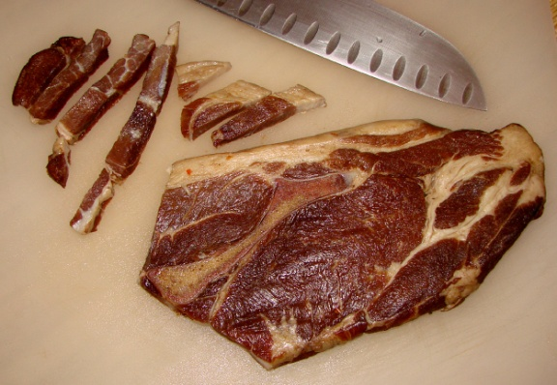
Starter
If a nuclear holocaust was imminent, what kind of food would you stock in your bomb shelter to last you through the next few months?
Canned Food
Dry Cereals
Pickled Food
Dried/
Salted
Snacks
Smoked
Food

Slide 4
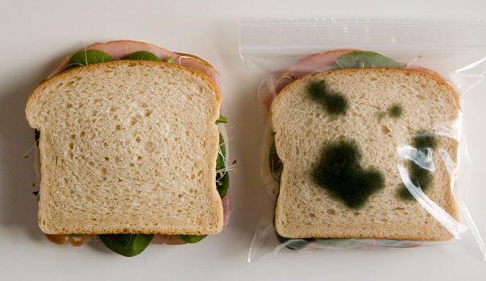
Food Spoilage
How do we know food is spoilt?
For example, meat left out for a while may be covered in harmful bacteria.
The meat may look fine to eat, but consumption could cause major illness.
The signs of food spoilage are not always immediately visible.

Slide 5
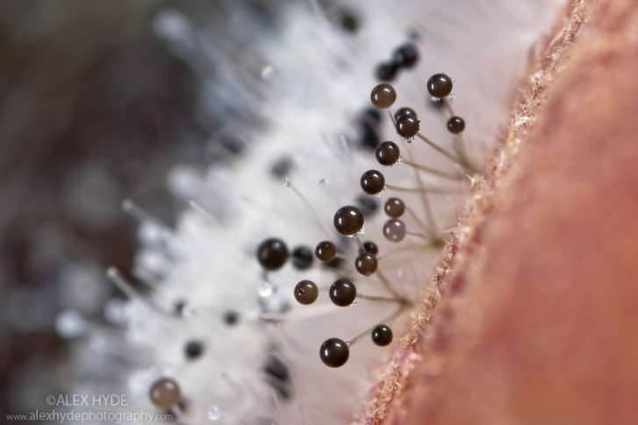
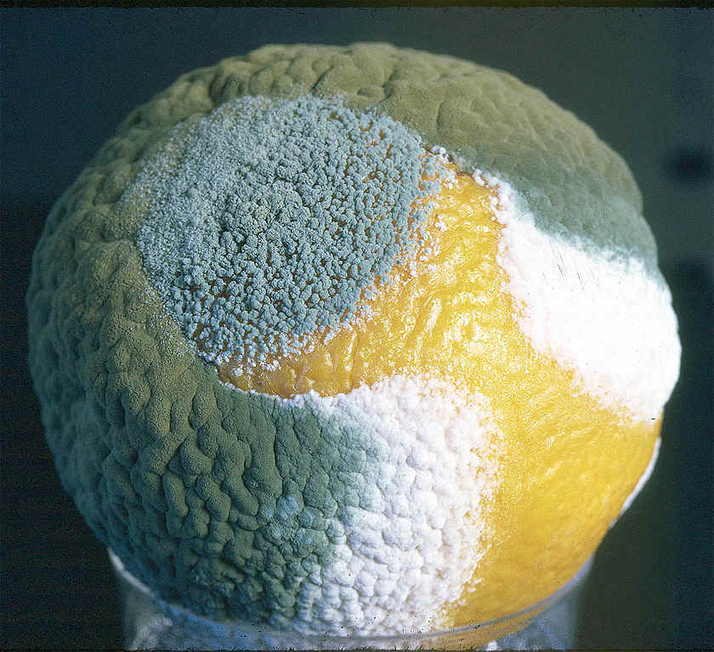
Food Spoilage – Visible Growth
Moulds are the most obvious visible form of microorganism on our food.
Fungi like the ones above feed saprophytically.
This means they secrete enzymes onto food and then absorb the products into their cells.
An orange covered in Penicillium fungus
Mucor fungus on bread.

Slide 6
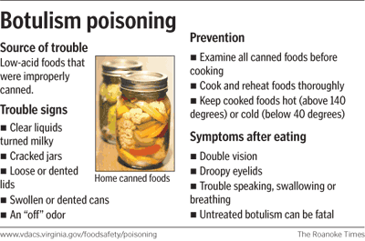
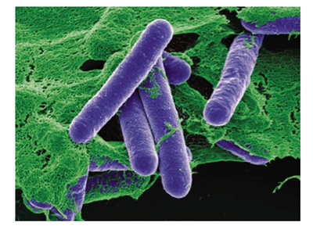
Food Spoilage – Toxins
Some microorganisms release toxins onto our food.
This can cause serious illness, especially in the case of Clostridium botulinium.
This bacteria releases botulin, of which as little as 1µg can kill a person.
C. botulinium causes the disease, botulism.

Slide 7
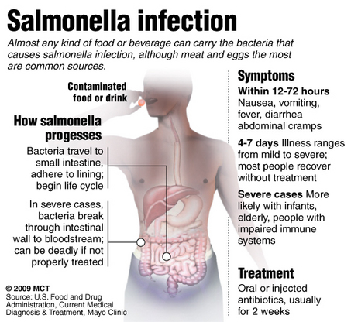
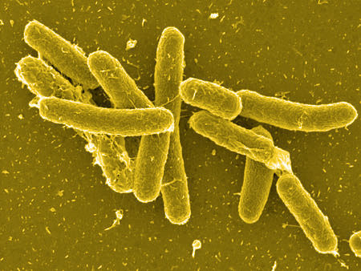
Food Spoilage – Infection
A very common problem caused by eating spoilt food is infection.
Salmonella bacteria is associated with poultry (both meat & eggs).
The bacteria attack the lining of the stomach and intestine.

Slide 8
Preventing Food Spoilage

Slide 9
Preventing Food Spoilage
Use the bottom half of page 158 to find out how fresh food can be saved from spoilage.
Method | How it works...
Cooking | Heat kills any bacteria present. Denatures enzymes.
Pasteurising
Drying/Salting
Smoking
Pickling
Irradiation
Cooling/Freezing

Slide 10
Microorganisms In Making Food

Slide 11
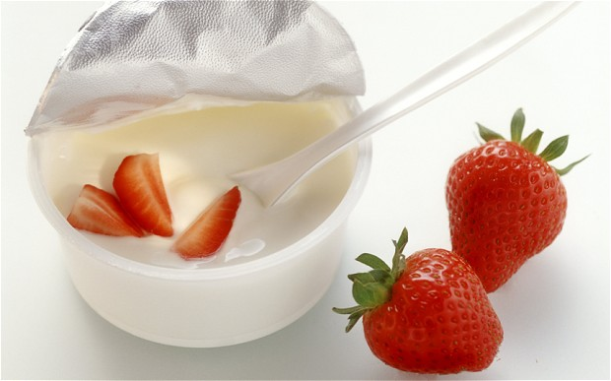
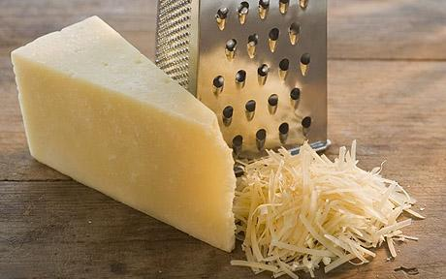
Microorganisms in Making Food
Microorganisms aren’t all bad – they can be used to make food too.
Yoghurt
Lactobacillus uses lactose in milk to make lactic acid. The milk is partially digested by the bacteria.
This makes it easy to digest for us.
Cheese
Milk is allowed to curdle. The solid, curdled milk is acted upon by Lactobacillus and additional flavours can be achieved by contamination with Penicillium.
(e.g. Blue cheese)

Slide 12
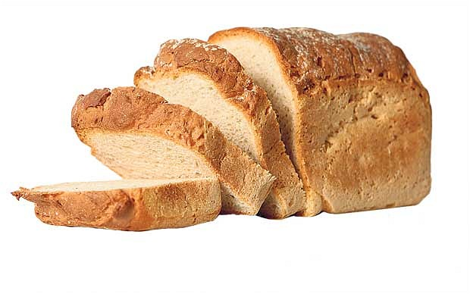
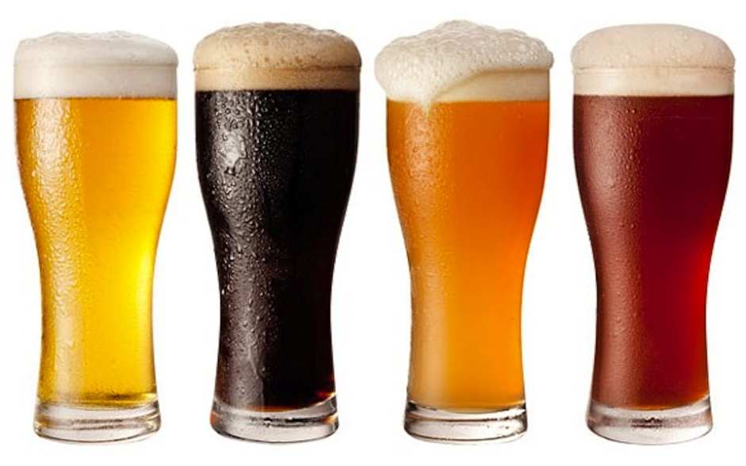
Microorganisms in Making Food
Bread
Bread is made to rise by yeast.
Yeast respires anaerobically, releasing carbon dioxide bubbles.
These cause bread to rise.
Alcohol
Cereal grains contain the sugar maltose, which yeast respire upon.
Alcohol is produced as a product of anaerobic respiration by the yeast.
Cereals are replaced with grapes when making wine.

Slide 13
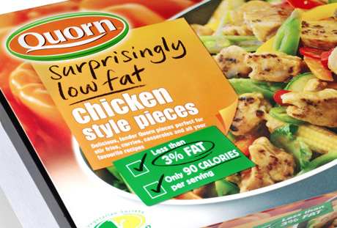
QuornTM
A very well-known protein produced by a fungus is mycoprotein.
This is the protein present in the meat-substitute food product known as Quorn.
Quorn is a very healthy option as it contains no animal fat or cholesterol, which as you now know can be harmful to health.
The mycoprotein in Quorn is made by the fungus:
Fusarium venenatum

Slide 14
Advantages & Disadvantages of Using Microorganisms
Production of protein can be sped up.
Production can be increased/decreased according to demand.
No animal welfare issues.
Good source of protein for vegetarians.
Protein contains no animal fat or cholesterol.
Production could be combined with the removal of waste products.
Some people might not want to eat it.
Isolation of the protein from fungus is difficult.
Protein has to be purified to ensure it’s not contaminated.
Conditions are also ideal for pathogenic bacteria.
The protein doesn’t have the exact taste/texture of traditional protein sources.

Slide 15
Plenary Questions
What is meant by food spoilage and how is it caused?
Describe how the processes of heating and cooling help to preserve foods.

Slide 16
Learning Objectives
Success Criteria
Understand that food spoilage can be harmful to human health.
Understand the methods used to prevent food spoilage.
Understand how microorganisms can be used to make food.
Discuss the advantages and disadvantages of using microorganisms.
Recall the ways in which food spoilage can be seen (E-D)
Describe the ways in which food spoilage can be prevented (C-B).
Explain how microorganisms can be used to make food and the advantages/disadvantages of this (A-A*)

