Slide 1
Lesson 5 Transmission of Diseases
OCR AS Biology – F212 – Module 2
Food & Health

Slide 2
Learning Objectives
Success Criteria
Understand the causes and means of transmission of malaria, HIV/AIDS and TB.
Understand the global impact of the three diseases.
Describe common features of the transmission of all diseases (E-D)
Describe the transmission of malaria, HIV/AIDS and TB (C-B)
Explain The global impact of the three diseases and possible future implications. (A-A*)

Slide 3
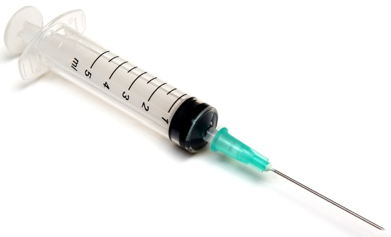
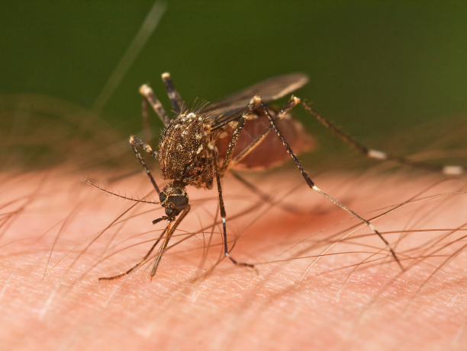
Starter
Match the disease to it’s most likely ‘carrier’ (Vector):
Malaria
HIV/AIDS
Tuberculosis

Slide 4
The Transmission of a Disease
Copy out the following sentence and then put the boxes in the correct order….
In order to cause a disease, a pathogen must be able to:
Reproduce
Cause damage to the host’s tissues
Travel from one host to another
Get into the host’s tissues
3
4
1
2

Slide 5
Today’s Focus…
Importance of, and Transmission of:
Malaria - Vector
HIV/AIDS - Physical Contact
Tuberculosis - Droplet Infection

Slide 6
Malaria

Slide 7
Malaria
Malaria is caused by the eukaryote, Plasmodium, of which there are four species:
Malaria is spread by a vector; the female Anopheles mosquito.
When the mosquito feeds on blood, it carries the Plasmodium from an infected person to an uninfected person.
The malarial parasite (Plasmodium) lives in red blood cells and feeds on haemoglobin.
Most widespread
P. falciparium
P. vivax
P. ovale
P. malariae

Slide 8
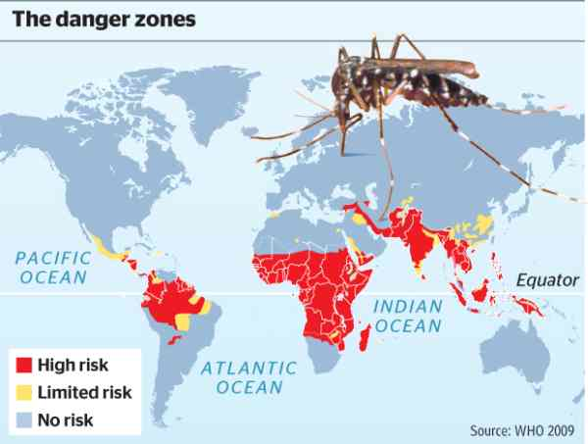
Global Impact of Malaria
Malaria affects around 300 million people a year, of which it kills around 3 million.
Malaria occurs wherever its vector (Anopheles) lives.
Anopheles currently lives in tropical regions, but rising global temperatures means that soon it may even be able to survive in Europe.
←
Malarial risk map.
90% of cases occur in sub-Saharan Africa.

Slide 9
START

Slide 10
Transmission of Malaria
Use page 163 of the textbook to put the following stages in order:
Gametes fuse and form the zygote in the mosquito’s stomach.
It now enters the blood, where new gametes are produced.
Plasmodium develops and moves to salivary glands.
Mosquito draws in malarial-parasite gametes during a blood-meal.
Mosquito bites another human and infects them with the parasite.
The infective stage of the parasite enters the liver and multiplies.

Slide 11
Answer
Mosquito draws in malarial-parasite gametes during a blood-meal.
Gametes fuse and form the zygote in the mosquito’s stomach.
Plasmodium develops and moves to salivary glands.
Mosquito bites another human and infects them with the parasite.
The infective stage of the parasite enters the liver and multiplies.
It now enters the blood, where new gametes are produced.

Slide 12
HIV/AIDS

Slide 13
HIV/AIDS
HIV/AIDS is caused by the human immunodeficiency virus.
Once it enters the body, the virus may remain inactive (HIV-positive).
When activated, the virus kills T helper cells, which normally prevent infection.
A person will then be susceptible to other pathogens and may contract opportunistic infections, which could kill them.

Slide 14
Unprotected sex
Body-fluid exchange (blood)
Unscreened blood transfusions
Transmission of HIV
Mother-baby during breastfeeding
Use of unsterilised surgical equipment
Across placenta during childbirth
Sharing hypodermic needles
Needle-stick injuries

Slide 15
Task
Use Figure 2 on page 165 of the student textbook to:
Create a bar chart showing the prevalence of AIDS in 2005.
By 2006/07 HIV/AIDS was spreading rapidly in China.
Soon, the number of cases in China is expected to exceed the number of cases in any other country.

Slide 16
Tuberculosis

Slide 17
Tuberculosis
TB is a bacterial infection transmitted by droplet infection.
Tiny droplets of liquids released when an infected person sneezes contain the bacteria:
The bacteria is usually found in the lungs.
Conditions that increase risk of contraction include:
Overcrowding
Poor ventilation
Poor health
Poor diet
Homelessness
Mycobacterium tuberculosis
or
Mycobacterium bovis

Slide 18
Tuberculosis
Like the previous 2 diseases, TB is a worldwide disease.
Approximately 1% of the world’s population is newly infected every year.
Current estimates suggest that up to 30% of the world’s population may be infected with Mycobacterium*.
TB is common in South-east Asia and in Sub-Saharan Africa.
There is a threat from new strains of Mycobacterium that are resistant to most of the drugs available to treat it.
* Most peoples’ immune system keeps the disease at bay

Slide 19
Homework
TB Exam Question
6 marks

Slide 20
Plenary Questions
What diseases can be spread by sneezing?
Explain why somebody with AIDS is at high risk of death due to influenza.
Explain why people living in less economically developed countries are more likely to suffer from infectious diseases.

Slide 21
Learning Objectives
Success Criteria
Understand the causes and means of transmission of malaria, HIV/AIDS and TB.
Understand the global impact of the three diseases.
Describe common features of the transmission of all diseases (E-D)
Describe the transmission of malaria, HIV/AIDS and TB (C-B)
Explain The global impact of the three diseases and possible future implications. (A-A*)

