Slide 1
Lesson 6 Non-Specific Responses to Diseases
OCR AS Biology – F212 – Module 2
Food & Health

Slide 2
Learning Objectives
Success Criteria
Understand what the primary defence mechanisms against disease are.
Understand the role played by phagocytic cells as secondary defence mechanisms.
Recall the main primary defence mechanisms (E)
Describe the role played by skin and mucus to prevent infection (D-C)
Describe the action of neutrophils and macrophages in fighting pathogens (B)
Explain how phagocytosis works to engulf pathogens (A)

Slide 3
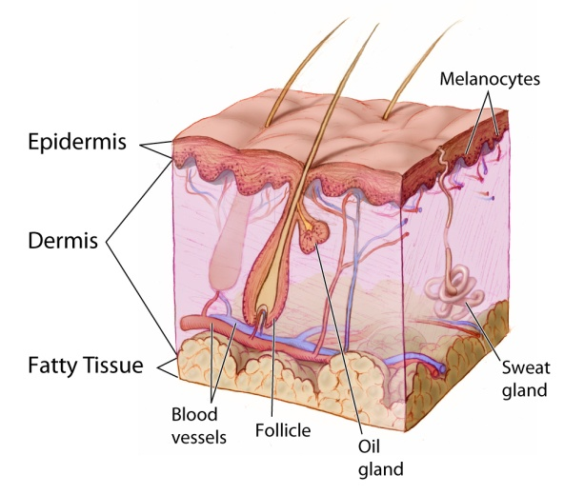
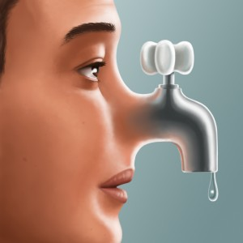
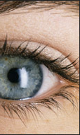
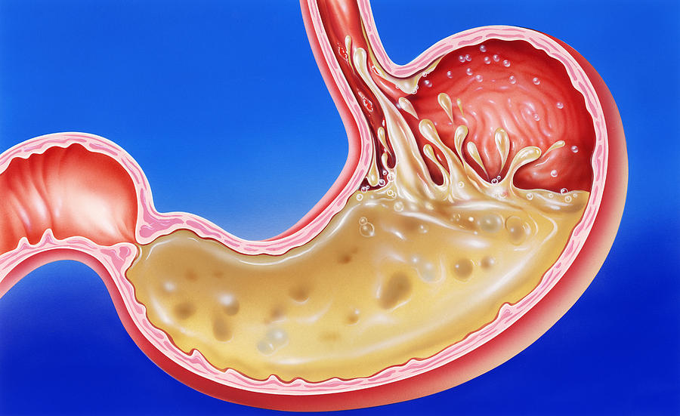
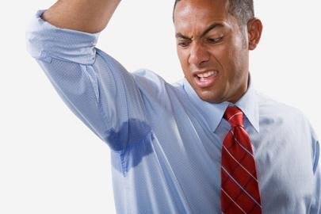
Starter Question
What are the first lines of defence that the body has against disease?
Skin
Mucus
Chemicals in tears
Stomach acid
Chemicals in sweat

Slide 4
Primary Defences
Before a pathogen can harm a host, it must first enter the host.
The mechanisms that have evolved to prevent the entry of pathogens are called primary defences.
!! Remember !!
Primary defences don’t rid the body of pathogens, or fight disease. They simply prevent infection.

Slide 5
Primary Defence 1: Skin
The skin is the main primary defence.
It acts as a barrier to pathogens.
The outer layer is called the epidermis.
Young keratinocyte cells form by mitosis towards the bottom of the epidermis.
They migrate towards the surface, where their cytoplasm is replaced by the protein keratin.
This keratinised layer acts as an anti-pathogen barrier.
The whole process takes around 30 days.

Slide 6
Primary Defence 2: Mucous Membranes
Our airways, lungs and digestive systems are areas where pathogen may enter the body.
The epithelial layers of these areas contain goblet cells, which secrete mucus.
The mucus traps pathogens.
The epithelium is lined with ciliated cells. These cilia rhythmically beat the mucus and pathogens towards the oesophagus.
Explain why swallowing the mucus and pathogens is not harmful.

Slide 7
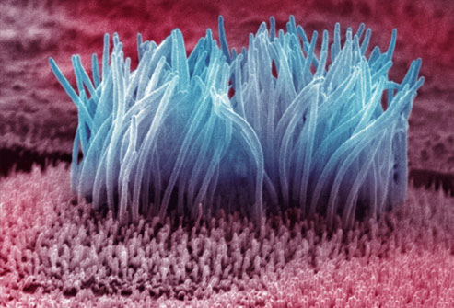
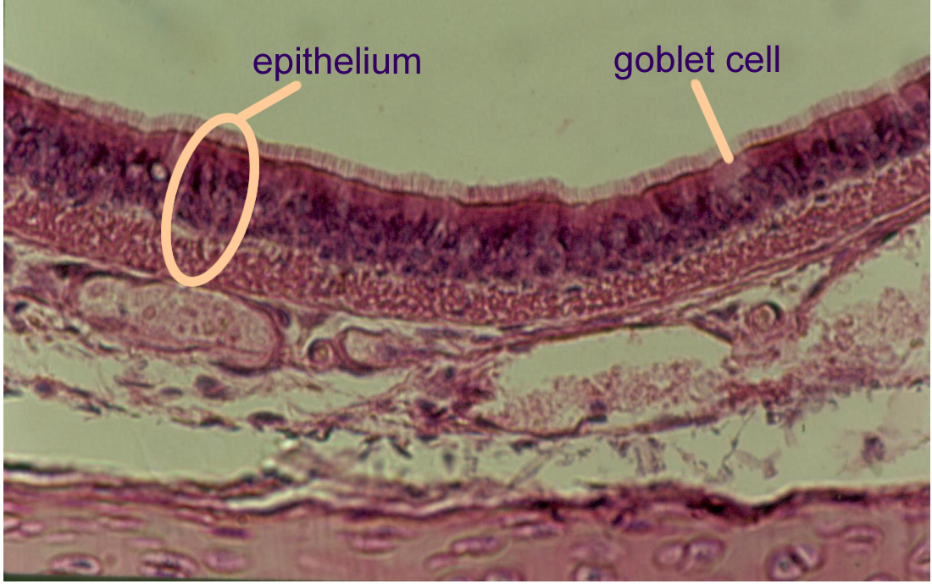
cilia

Slide 8
Other Primary Defences:
The eyes are protected by antibodies in the tear fluid.
The ear canal is lined with wax, which traps pathogens.
The vagina is protected by maintaining acidic conditions.
The anus also has a mucous membrane.

Slide 9
Secondary Defence: Phagocytes

Slide 10
Phagocytes
If the primary defences fail to prevent entry of pathogens, it is the job of phagocyte cells to kill them.
There are two types of phagocyte:
Neutrophils – the most common form of phagocyte.
Macrophages (discussed later)
phagocyte
pseudopodia
pathogen

Slide 11
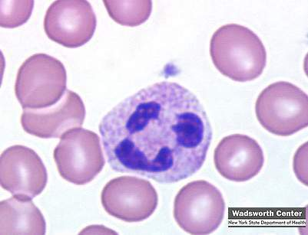
Phagocyte #1 : Neutrophils
Neutrophils are manufactured in the bone marrow, and have a multilobed nucleus:
As shown in the picture, neutrophils travel in the blood, but can also be found in:
Tissue fluid
Epithelium of the lungs
Neutrophils are release in vast amounts after an infection.
A neutrophil amongst red blood cells.
The nucleus has three visible lobes.

Slide 12
Phagocyte #2 : Macrophages
Macrophages are similar to neutrophils, but are larger and are generally found in the lymph nodes.
Before this, when they are in the blood, they are known as monocytes.
What do macrophages do?
Infected cells release histamine, which cause capillaries to become ‘leaky’.
This causes swelling as fluid enters the tissue fluid.
The tissue fluid (and pathogens) enter the lymphatic system, where the macrophages are waiting!
The macrophages play a massive part in starting a SPECIFIC immune response.
We will see this in the coming lessons.
IMPORTANT!

Slide 13
Non-Specific Responses to Disease
Primary Defences
Secondary Defences
Skin
Mucous Membrane
etc.
Neutrophils
Macrophages
Lead to a specific response by the immune system

Slide 14
Task – Phagocytosis Comic Strip
Use the ‘How Phagocystes Work’ section on page 167 of the textbook to create a comic about the action of phagocytes.
Make sure you include all of the detail in the book.
Use Figure 2 in the textbook to help you.

Slide 15
Plenary Questions
Describe how a neutrophil performs phagocytosis.
Explain what is meant by a non-specific response

Slide 16
Learning Objectives
Success Criteria
Understand what the primary defence mechanisms against disease are.
Understand the role played by phagocytic cells as secondary defence mechanisms.
Recall the main primary defence mechanisms (E)
Describe the role played by skin and mucus to prevent infection (D-C)
Describe the action of neutrophils and macrophages in fighting pathogens (B)
Explain how phagocytosis works to engulf pathogens (A)

