Slide 1
Lesson 8 Antibodies & vaccination
OCR AS Biology – F212 – Module 2
Food & Health

Slide 2
Learning Objectives
Success Criteria
Understand the role played by antibodies in the immune system.
Understand the the uses and importance of vaccination in preventing/treating disease.
Describe the structure of an antibody (D-C)
State the two ways in which antibodies fight pathogens (B-A)
State what a vaccine is (D-C)
Distinguish between different types of immunity (B-A)

Slide 3
Starter Question
List the names of as many cells to do with the immune system as you can:
Macrophage
Neutrophil
T-lymphocyte
T-helper
B-lymphocyte
T-killer
B-memory
T-memory
Plasma Cell

Slide 4
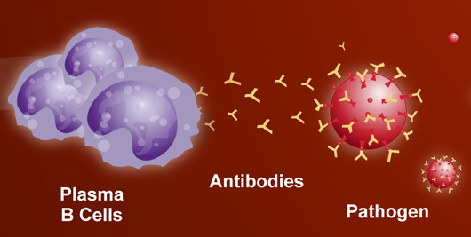
Recap of the Specific Immune System
Remember that after stimulation by T-helper cells, B-lymphocytes differentiate into Plasma Cells.
Plasma cells secrete antibodies which work to fight off pathogens.
Don’t forget that some B-lymphocytes also turn into B-memory cells.
These release antibodies during a secondary infection.
Brief video on Antibodies

Slide 5
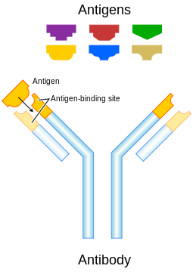
Antibodies
Antibodies are large proteins, also known as immunoglobulins.
Their shape is complementary to a particular antigen.
Our immune system manufactures one type of antibody for every antigen detected.
They have a characteristic ‘Y’ shape.
All antibodies contain very similar features…

Slide 6
Antibody Structure
Variable Region
Hinge Region
Light Chain
Constant Region
Heavy Chain

Slide 7
Antibody Structure
Four polypeptide chains held together by disulphide bridges.
A constant region which is identical to that in all antibodies.
A variable region which is specific to the shape of a particular antigen.
A hinge region which allows for flexibility and attachment to more than one antigen.

Slide 8
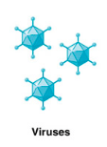
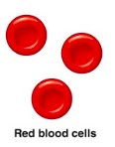
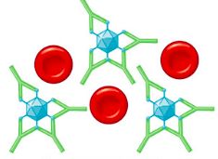
How Antibodies Work - Neutralisation
The antigens on some pathogens act as binding sites, which allow them into body cells.
If complementary antibodies attach to the antigens, the pathogen will be blocked from entering body cells.
antibodies
The antigens on these viruses allow them to enter red blood cells.
Antibodies have attached to the antigens, blocking entry to the red blood cells.
This is called Neutralisation

Slide 9
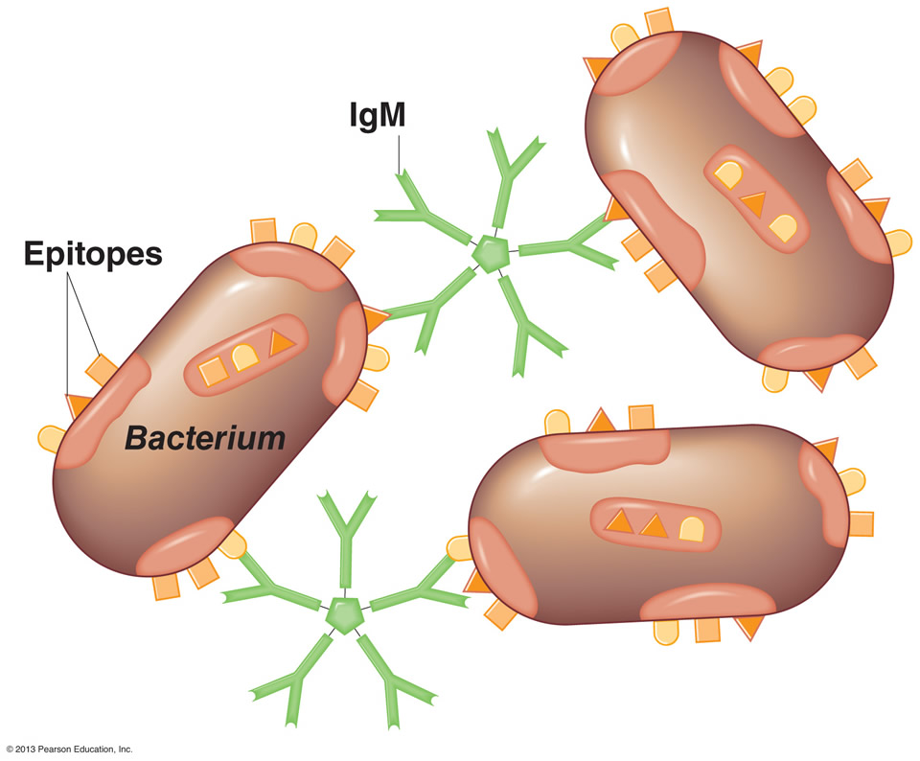
How Antibodies Work - Agglutination
Some antibodies are different to the conventional ‘Y’ shape.
They look like multiple antibodies joined together.
The multiple antigen-binding sites mean that several pathogens can be clumped together.
When pathogens are stuck together, they cannot enter body cells.
This is called Agglutination

Slide 10
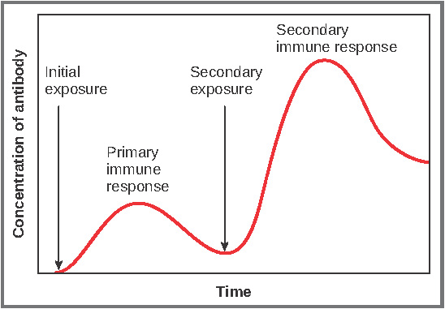
Primary & Secondary Immune Responses
After the initial exposure to a pathogen, antibody production is small-scale and takes a while.
Due to the production of memory cells, a second attack by the pathogen will be dealt with swiftly.
This time antibodies are produced in greater numbers and more rapidly.
This swifter and stronger attack is known as the:
Secondary Immune Response

Slide 11
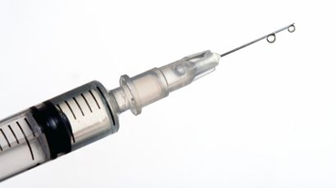
Vaccination

Slide 12
What’s a Vaccine?
Vaccines are simple.
To stimulate the immune response, vaccines can contain:
Whole, live microorganisms (not as harmful as the real deal).
A weakened or attenuated form of the pathogen.
A dead pathogen.
Just the isolated antigens (no pathogen).
Harmless forms of toxins.
A vaccination is a deliberate exposure to antigenic material, which activates the immune system to make a response and provide immunity.
A vaccinated person is said to have:
Artificial Active Immunity

Slide 13
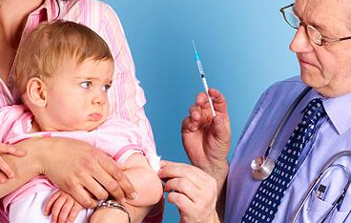
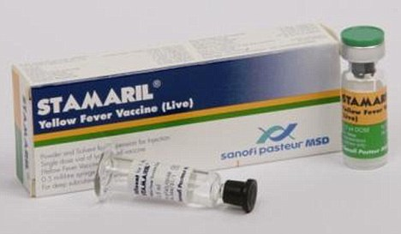
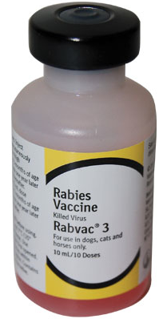
You can get vaccines for…
… protection against childhood diseases.
… prevention of tropical disease contraction when travelling abroad.
… protection against a disease once it has been contracted.

Slide 14
Active & Passive Immunity
Active immunity is achieved by the activation of the immune system.
Passive immunity is provided by antibodies that have not been produced by the immune system.
Active immunity usually lasts for many years.
Passive immunity is short-lived.
Both types of immunity can be achieved either naturally or artificially.

Slide 15
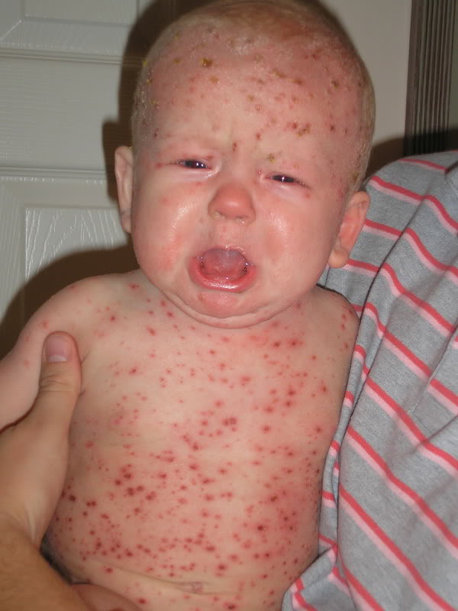
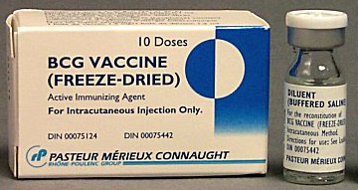
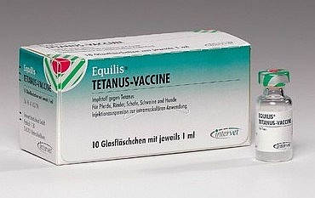
Match the pictures to the correct description, and then to the correct example of immunity…..
An injection of antibodies made by another organism.
ACTIVE/NATURAL
Immunity provided by the immune system, when stimulated by an infection.
PASSIVE/NATURAL
Immunity provided by the injection of weakened/dead pathogens.
ACTIVE/ARTIFICIAL
Passing antibodies to a baby either via the placenta or by breastfeeding.
PASSIVE/ARTIFICIAL

Slide 16
Plenary Questions
Why has it proven to be so difficult to rid the world of cold and influenza viruses?
HOMEWORK:
Use the internet to find examples of ‘herd’ and ‘ring’ vaccination.
Bring information to class next lesson to discuss and add to your biology folder.

Slide 17
Learning Objectives
Success Criteria
Understand the role played by antibodies in the immune system.
Understand the the uses and importance of vaccination in preventing/treating disease.
Describe the structure of an antibody (D-C)
State the two ways in which antibodies fight pathogens (B-A)
State what a vaccine is (D-C)
Distinguish between different types of immunity (B-A)

