Slide 1
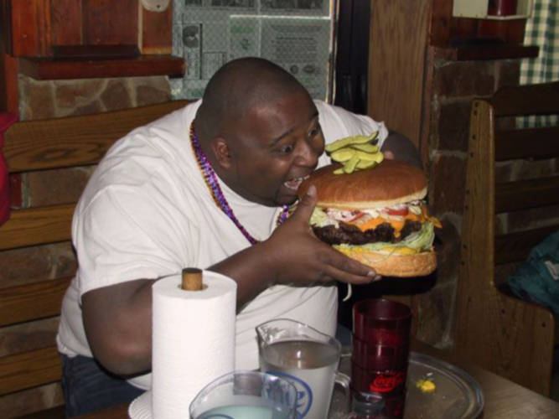
3.4 – Lipids (Fats)

Slide 2
Learning Objectives
Learn what a triglyceride is.
Learn what a fatty acid is.
Learn the structure of a phospholipid.
Learn how lipids are tested for.

Slide 3
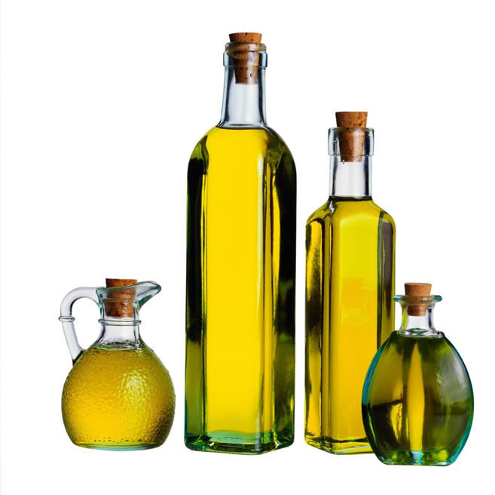
What is a lipid?
Like most other biochemical substances, lipids contain carbon, hydrogen and oxygen.
The proportion of oxygen though, is way smaller than in carbohydrates.
In fact, unlike carbohydrates, lipids are not even polymers.
They are made of a GLYCEROL molecule and a
few FATTY ACIDS.
fatty acid
glycerol
fatty acid
fatty acid

Slide 4
The roles of lipids
The most important thing you need to know about them is that they form PLASMA MEMBRANES.
The specific lipid here is the PHOPHOLIPID.
Other uses include:
Energy source
Waterproofing – plants and animals have a waxy
cuticle. Mammals release sebum.
Insulation
Protection – delicate organs like the kidneys
and heart have fat around them
The main groups of lipids are the TRIGLYCERIDES and PHOSPHOLIPIDS

Slide 5
Digestion Recap (answer in your notes)
What enzyme is responsible for breaking down lipids?
What substance produced by the liver aids in lipid digestion?
Explain what happens in condensation and hydrolysis reactions.

Slide 6
Triglycerides
Mostly fats and oils

Slide 7
Triglycerides
Triglycerides are composed of a glycerol molecule and three fatty acids.
The glycerol and fatty acids are combined in a condensation reaction.
CH₂OH
HOOC
Fatty acid 1
H₂O
H₂O
CH₂OH
HOOC
H₂O
Fatty acid 2
CH₂OH
HOOC
Fatty acid 3
CH₂O
OC
Fatty acid 1
CH₂O
OC
Fatty acid 2
CH₂O
OC
Fatty acid 3

Slide 8
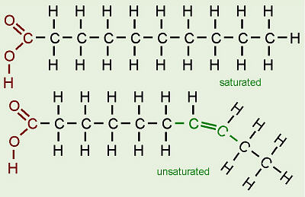
Fatty Acids in detail
Fatty acids are not as simple as this:
They actually look like this:
There are about 70 different fatty acids.
They all have a carboxyl group (-COOH), which is what makes them an acid.
HOOC
Fatty acid 1

Slide 9
Fatty Acids in detail
You can see that fatty acids are basically a carboxyl group attached to a chain of hydrocarbons.
If the hydrocarbon chain only has single-bonds, then the fatty acid is described as SATURATED (“full”)
If the hydrocarbon chain has double-bonds in it (anywhere), the fatty acid is described as UNSATURATED.
One double-bond = mono-unsaturated
More than one double-bond = poly-unsaturated

Slide 10
As you can see, lipids made up of saturated fatty acids, would be able to pack together tightly, due to no bends in their structure....
.... Due to this, saturated fats are usually solid (like butter).
Unsaturated fats however, have double-bonds in their fatty acids, meaning they can’t pack together tightly. This makes them liquid near to room temperature – i.e. They are usually oils.

Slide 11
phospholipids
The stuff of membranes

Slide 12
Phospholipids
These are similar to the triglycerides that make up lipids, but one of the fatty acids, is replaced by a PHOSPHATE MOLECULE.
So not like this....
CH₂OH
HOOC
Fatty acid 1
CH₂OH
HOOC
Fatty acid 2
CH₂OH
HOOC
Fatty acid 3
CH₂OH
HOOC
Fatty acid 1
But like this....
CH₂OH
HOOC
Fatty acid 2
Phosphate
Head
CH₂

Slide 13
Phospholipids
You can see that phospholipids have:
A hydrophilic head (which interacts with water)
A hydrophobic tail (which keeps away from water)
CH₂OH
HOOC
Fatty acid 1
Fatty acids are hydro-phobic
CH₂OH
HOOC
Fatty acid 2
Phosphates are hydro-philic
Phosphate
Head
CH₂
So...
Rather than visualise a plasma membrane as just two lines, what do you think a plasma membrane (remember, it’s technical name?) looks like on a molecular level?

Slide 14
That’s right!

Slide 15
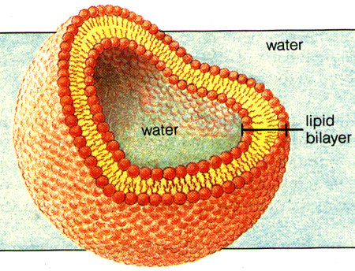
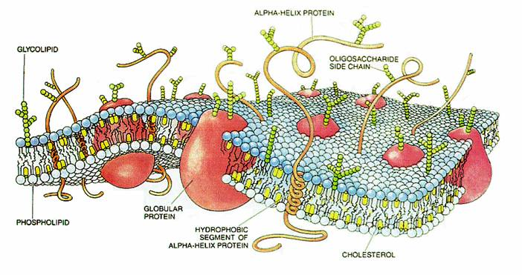

Slide 16
Testing for lipids
It’s quite boring

Slide 17
The Emulsion Test
Grab a clean, dry test-tube.
To around 2cm³ of the sample being tested, add around 5cm³ of ethanol.
Shake the tube violently to dissolve the lipid in the sample.
Add 5cm³ of water and shake slightly less violently.
If the contents of the tube turn cloudy-white, a lipid is present.
As a control, use water as a sample.
Do the summary questions in the book (page 51)

Slide 18
Learning Objectives
Learn what a triglyceride is.
Learn what a fatty acid is.
Learn the structure of a phospholipid.
Learn how lipids are tested for.

