Slide 1
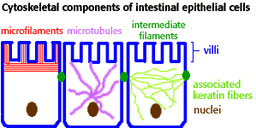
Cells – Animal, Plant, Eukaryote, Prokaryote
Make a model cell. In groups – animal or plant cell
Design a mark scheme to assess the model

Slide 2
Animal v Plant cells
Learning Objectives
Success Criteria
Produce a model comparing animal and plant cells
Describe the structure and function of organelles
Construct a mindmap to show how the cytoskeleton allows stability and movement of and within vells.
Compare the structure and ultra-structure of plant cells with that of animal cells
Outline the functions of the structures found in cells

Slide 3
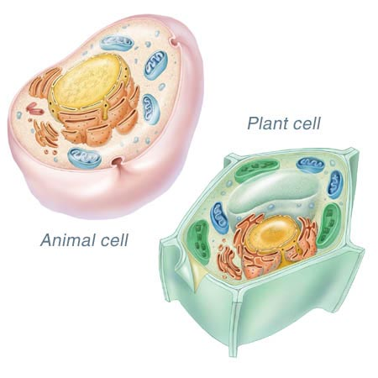
How much does your model look like these?
Peer Assess each others models!

Slide 4
Comparison Table
List the main similarities and differences between animal and plant cells
Draw and label a diagram of a cell or further annotate your cheat sheet to include any further details from p10-11 not included.
Make sure you highlight any parts that maintain stability and enable movement of/within the cell

Slide 5
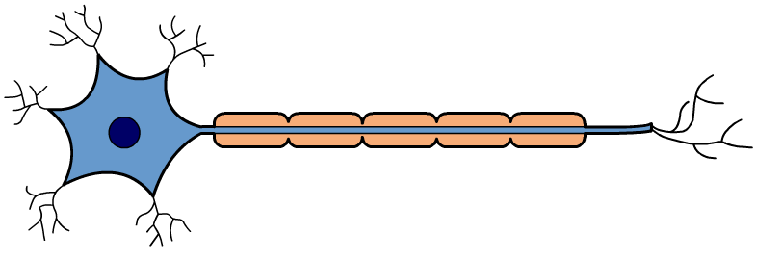
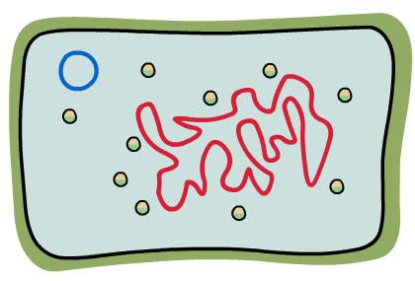
What is a cell?
Cells are the basic unit of life. They are small membrane-bound structures containing several smaller structures called organelles.
There are two main categories of cell, each of which have important different structural properties:
eukaryotic cell, including the cells of animals and plants
prokaryotic cell, including bacterial cells.

Slide 6
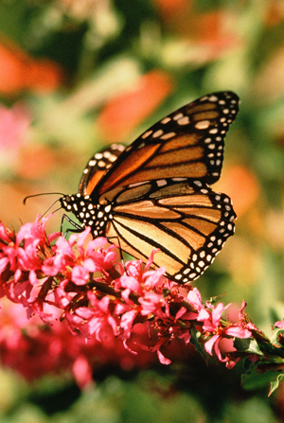
What is a eukaryote?
A eukaryote is any organism consisting of one or more cells that contain DNA in a membrane-bound nucleus, separate from the cytoplasm.
Eukaryotes include:
animals
plants
fungi
a diverse group known as the protists (or protoctists).
All eukaryotic cells contain a large number of specialized, membrane-bound organelles.
Notes:
Photo credit: Jupiterimages Corporation
Teacher notes
See the ‘Classification’ presentation for more information about the relationship between the eukaryote kingdoms.

Slide 7
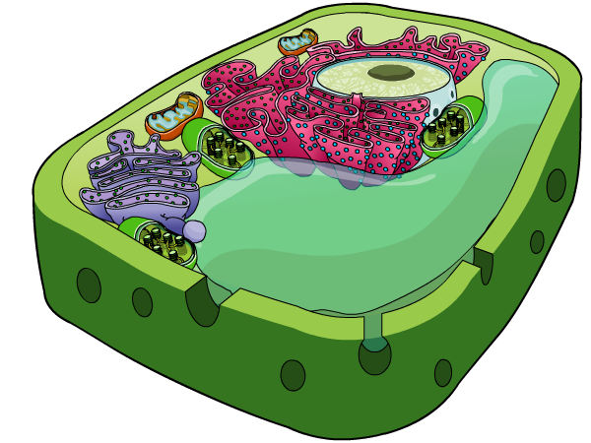
Plant cells
Plant cells share all the common features of animal cells, but also contain some additional organelles.
Plants gain all their energy from sunlight; cells in their leaves contain many chloroplasts to convert this into a useful form.
chloroplast
vacuole
Every plant cell is surrounded by a cell wall, and contains one or more permanent vacuoles.
cell wall

Slide 8
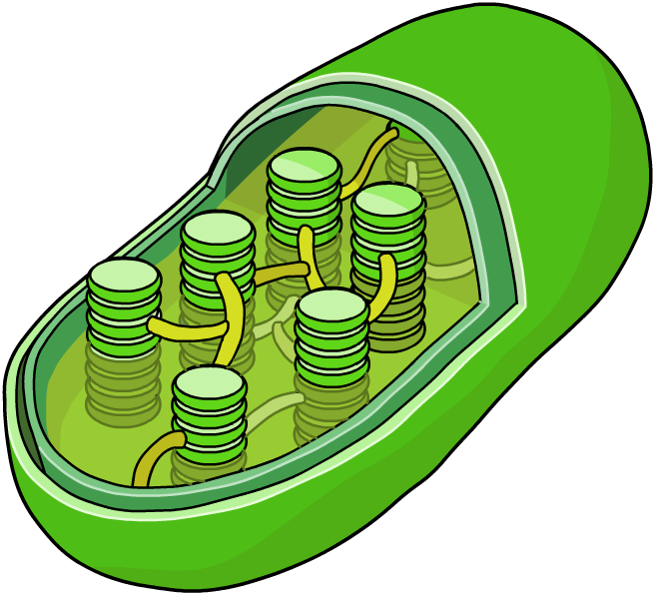
Chloroplasts
Chloroplasts use carbon dioxide, water and light energy to build sugars. They are present in all green plants.
The chloroplast is surrounded by a double membrane. It is filled with a liquid called the stroma, and contains stacks of thylakoid membranes called grana.
grana
stroma
thylakoid membrane
The thylakoid membranes are the site of photosynthesis.
Notes:
Teacher notes
Chloroplasts use the light energy absorbed by chlorophyll to build sugars. These are converted into complex carbohydrates to store energy for all the plant’s needs.

Slide 9
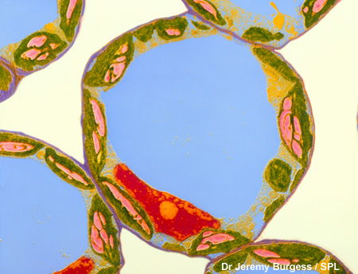
Vacuoles
Permanent vacuoles only exist in plant cells. Animal cells can contain temporary vacuoles but they are not common features.
A vacuole consists of a membrane called the tonoplast, filled with cell sap – a watery solution of different substances, including sugars, enzymes and pigments.
The vacuole is important in keeping the cell firm. When the vacuole is full of sap the cell is said to be turgid.
Notes:
Photo credit: Dr Jeremy Burgess / Science Photo Library
Coloured Transmission Electron Micrograph (TEM) of mesophyll cells in a young leaf of Zinnia elegans. These cells contain large numbers of chloroplasts (green), and are therefore active centres of photosynthesis. The chloroplasts are situated on the edge of each cell; starch granules (pink) inside them are a form of stored sugar. At the centre of each cell is a large vacuole (blue) filled with cell sap. The nucleus is coloured red. Mesophyll cells are loosely arranged cells in the leaf, with large air spaces (white) between them, allowing for gas exchange during photosynthesis. Magnification: x2,000 at 6x4.5cm size.
Teacher notes
The vacuole contains enzymes, like a lysosome. Enzymes are produced by the endoplasmic reticulum, then packaged into lysosomes by the Golgi apparatus. These lysosomes may then fuse with a vacuole, depositing their contents.
See the ‘Transport Across Membranes’ presentation for more information about turgidity.

Slide 10
Animals vs. Plants
Animal Cells
Plant Cells
Plasma membrane
Nucleus
Mitochondria
Both types of ER
Golgi Body
Ribosomes
Lysosomes
Plasma membrane
Nucleus
Mitochondria
Both types of ER
Golgi Body
Ribosomes
Lysosomes
Cell Wall
Chloroplast
Vacuole

Slide 11
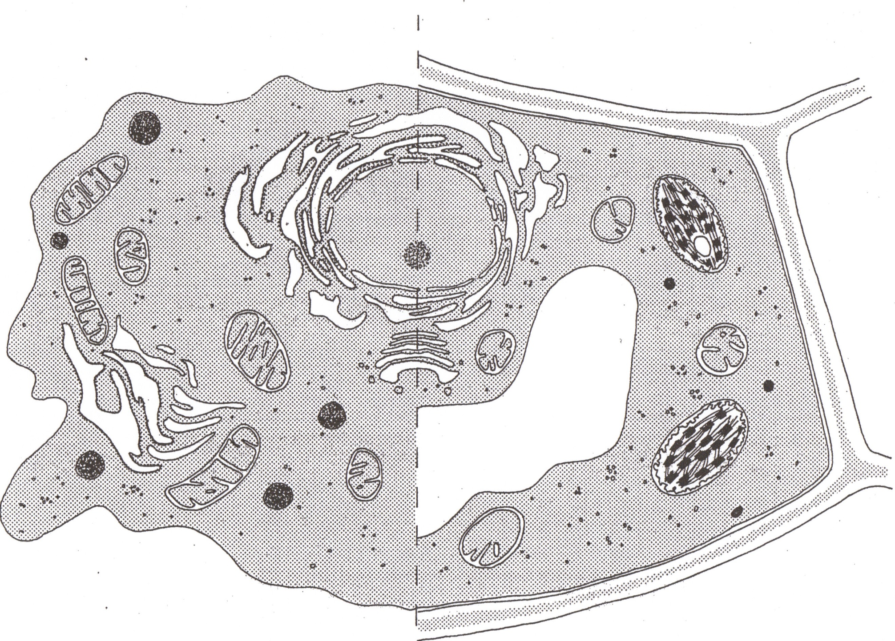
Animal Cell Plant Cell

Slide 12
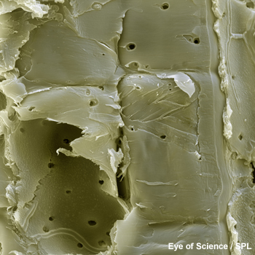
The cell wall
The cell wall of a plant cell gives it support and structure. It is made of the polysaccharide cellulose, and can function as a carbohydrate store by varying the amount of cellulose it holds.
The cell wall does not seal off a cell completely from its neighbours. There are pores within the walls called plasmodesmata. These connect two cells together by their cytoplasm, enabling the exchange and transport of substances.
Notes:
Photo credit: Eye Of Science / Science Photo Library
Coloured scanning electron micrograph (SEM) of the walls of plant cells (oblong) from a bamboo (family Gramineae). Unlike animal cells, plant cells are enclosed in a protective rigid cell wall. Channels (round) in the walls, known as plasmodesmata, allow transport and communication between the cells. Magnification: x1250 when printed at 10 centimetres wide.
Teacher notes
See the ‘Biological Molecules 1: Water & Carbohydrates’ presentation for more information about cellulose.

Slide 13
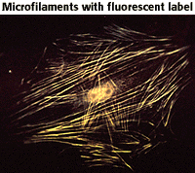
Cytoskeleton - microfilaments
The cytoskeleton is both a muscle and a skeleton, and is responsible for cell movement, cytokinesis, and the organization of the organelles within the cell.
The cytoskeleton is unique to eukaryotic cells. It is a dynamic three-dimensional structure that fills the cytoplasm.
Microfilaments
Microfilaments are fine, thread-like protein fibers, 3-6 nm in diameter. They are composed predominantly of a contractile protein called actin, which is the most abundant cellular protein. Microfilaments' association with the protein myosin is responsible for muscle contraction. Microfilaments can also carry out cellular movements including gliding, contraction, and cytokinesis.

Slide 14
Cytoskeleton - Microtubules
Microtubules Microtubules are cylindrical tubes, 20-25 nm in diameter. They are composed of subunits of the protein tubulin--these subunits are termed alpha and beta.
Microtubules act as a scaffold to determine cell shape, and provide a set of "tracks" for cell organelles and vesicles to move on.
Microtubules also form the spindle fibers for separating chromosomes during mitosis. When arranged in geometric patterns inside flagella and cilia, they are used for locomotion.

Slide 15
Cytoskeleton – Microtubule motors
Proteins attached to microtubules – move organelles and other components along fibres
eg chromosomes during mitosis
ATP is required

