Slide 1
The Nitrogen Cycle
Revision

Slide 2
Learning Objectives
To understand that the Nitrogen Cycle is composed of the following processes:
To be able to use this information to answer exam questions where applied knowledge is required.
Nitrogen-Fixation
Nitrification
Assimilation (uptake)
Ammonification
Denitrificaton

Slide 3
Nutrient Cycling
Matter cycles between the non-living and living components of an ecosystem.
Simple, inorganic molecules are fixed from the environment by producers and microbes.
These are then built in to complex, organic molecules which are passed down the food chain.
CO₂
C₆H₁₂O₆
SO₂
Producers
LIPIDS
N₂
H₂O
Microbes
DNA
NH₃
PO₄
PROTEINS
NON-LIVING COMPONENT
LIVING COMPONENT

Slide 4
Nutrient Cycling
Eventually the complex, organic molecules are returned to the environment by decomposers.
This is where matter returns to the non-living component of the ecosystem.
Without producers, microbes and decomposers there would be no nutrient cycling and no life.
CO₂
C₆H₁₂O₆
SO₂
Decomposers
LIPIDS
N₂
H₂O
DNA
NH₃
PO₄
PROTEINS
NON-LIVING COMPONENT
LIVING COMPONENT

Slide 5
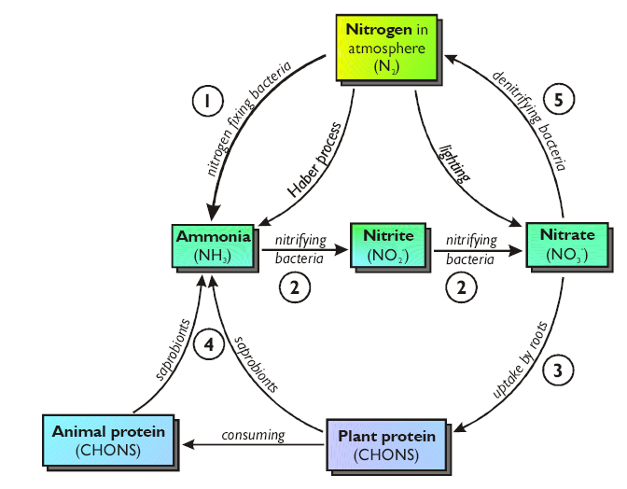
The Nitrogen Cycle

Slide 6
Nitrogen-Fixation
78% of the atmosphere is nitrogen gas (N₂).
The stable structure of nitrogen gas cannot be used as a source of nitrogen for growth.
The nitrogen in N₂ is fixed into useful compounds by nitrogen-fixing bacteria.
They reduce nitrogen gas to ammonia:
N₂ + 6H → 2NH₃
The NH₃ dissolves in soil water to form ammonium ions (NH₄⁺).

Slide 7
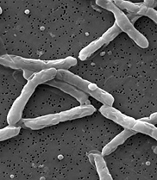
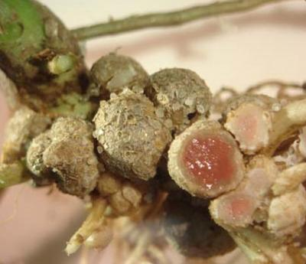
Nitrogen-Fixation (continued)
Nitrogen-fixing bacteria exist as free-living bacteria, but most live in colonies inside the root nodules of leguminous plants.
There are two other processes that fix nitrogen:
The Haber Process
N₂ + 3H₂ → 2NH₃
Lightning
N₂ + 2O₂ → 2NO₂
Nitrogen-fixing bacteria living in root nodules is an example of mutualism, where both species benefit.

Slide 8
Nitrification
A relatively simple process, nitrification converts ammonia into nitrate – which is a plants preferred form of nitrogen.
The process is carried out by nitrifying bacteria in two steps:
NH₄⁺ → NO₂⁻
NO₂⁻ → NO₃⁻
ammonia nitrite ions
nitrite ions nitrate ions
The ammonia that starts the nitrification process comes from:
Nitrogen-fixing bacteria
Haber process
Animal waste
Decomposition of dead organisms

Slide 9
Assimilation
Plants require nitrogen in the form of dissolved nitrates NO₃⁻.
Once the processes of nitrogen-fixation and nitrification have been carried out, plants are able to absorb NO₃⁻ by active transport.
Absorbed nitrates are used to synthesise amino acids and nucleic acids.
The uptake and incorporation of nitrogen into plant tissues is called assimilation.
This nitrogen is now available to the rest of the food chain through feeding.

Slide 10
Ammonification
When organisms die (and produce waste), microbial saprophytes release nitrogen locked in this material back to the environment.
More specifically, the proteins in detritus is broken down in two stages:
Step 1:
The saprophytes release enzymes which digest proteins into amino acids.
Step 2:
The amino group is removed from the amino acids, which then dissolves in soil to form NH₄⁺ ions.

Slide 11
Denitrification
Anaerobic bacteria called denitrifying bacteria are responsible for the constant loss of useful nitrogen from soil.
The bacteria thrive in oxygen-poor, water-logged soil.
Denitrifying bacteria ‘complete the jigsaw’ of the nitrogen cycle.
NO₃⁻ → N₂

Slide 12
The Nitrogen Cycle

Slide 13
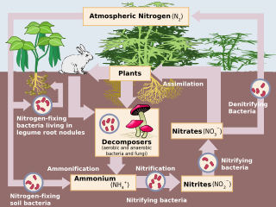

Slide 14
Learning Objectives
To understand that the Nitrogen Cycle is composed of the following processes:
To be able to use this information to answer exam questions where applied knowledge is required.
Nitrogen-Fixation
Nitrification
Assimilation (uptake)
Ammonification
Denitrificaton

