Slide 1
Unit 5: Control in cells and in organisms
Chapters:
9 – Response to stimuli
10 – Coordination
11 – Muscle contraction
12 – Homeostasis
13 – Feedback mechanisms
14 – Genetic control of protein structure and function
15 – Control of gene expression
16 – DNA technology
Exam dates:
Monday 17th June 2013 – PM
Length: 2 hours and 15 minutes
Total marks: 100
Percentage of A2: 23.3%
Unit introduction:
Multicellular organisms are able to control the activities of different tissues and organs within their bodies. They do this by detecting stimuli and stimulating appropriate effectors: plants use specific growth factors; animals use hormones, nerve impulses or a combination of both. By responding to internal and external stimuli, animals increase their chances of survival by avoiding harmful environments and by maintaining optimal conditions for their metabolism.
Cells are also able to control their metabolic activities by regulating the transcription and translation of their genome. Although the cells within an organism carry the same genetic code, they translate only part of it. In multicellular organisms, this control of translation enables cells to have specialised functions, forming tissues and organs. The sequencing and manipulation of DNA has many medical and technological applications.
Consideration of control mechanisms underpins the content of this unit. Students who have studied it should develop an understanding of the ways in which organisms and cells control their activities. This should lead to an appreciation of common ailments resulting from a breakdown of these control mechanisms and the use of DNA technology in the diagnosis and treatment of human diseases.

Slide 2
Unit 5: Chapter 9: Response to stimuli
9.1 Sensory reception:
What are a stimulus and a response?
What is the advantage to organisms of being able to respond to stimuli?
What are taxes, kineses and tropisms?
How does each type of response increase in organism’s chances of survival?
Key words:
alleles, selection pressure, taxes, kineses, tropisms
Fill in the blanks to show your understanding of stimulus and response:
Stimulus → __________ → __________ → __________ → response
Write a definition for tropism:
List the different types of tropism:
.
.
.
Explain the difference between:
positive tropism:
negative tropism:
Write a definition for taxes:
Explain the difference between:
positive taxes:
negative taxes:
Write a definition for kineses:
Explain the difference between:
positive kineses:
negative kineses:

Slide 3
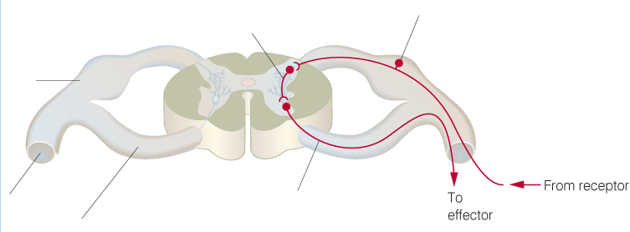
Unit 5: Chapter 9: Response to stimuli
9.2 Nervous control:
How does a simple reflex arc work?
What roles do sensory, intermediate and motor neurone play in a reflex arc?
How do reflex arcs prevent damage to the body?
Key words:
neurones, effector, synapse, motor, sensory, central nervous system, peripheral nervous system, voluntary, autonomic, spinal cord
Complete the diagram to show the organisation of the nervous system:
Label the diagram to show how the nerves are arranged in the spinal cord:
Nervous system
Brain
Describe the reflex arc that occurs when you touch a hot object:
Explain why reflex arcs are important:
Motor nervous system
Voluntary nervous system

Slide 4
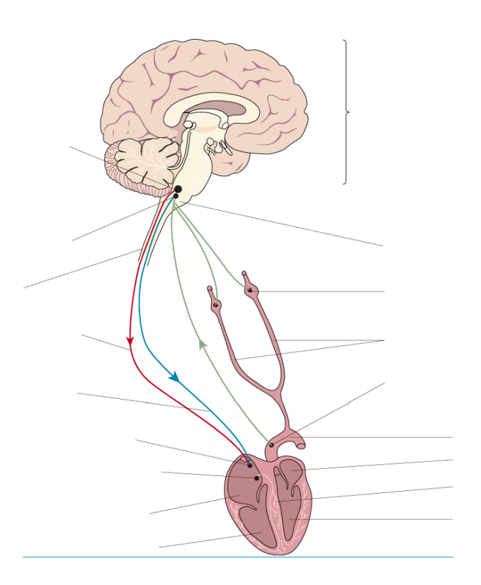
Unit 5: Chapter 9: Response to stimuli
9.3 Control of heart rate:
What is the autonomic nervous system?
How does the autonomic nervous system control heart rate?
What role do chemical and pressure receptors play in the process?
Key words:
sympathetic, parasympathetic, medulla oblongata, sinoatrial node, chemoreceptors, pressure receptors
What effect do these two systems have on heart rate:
Sympathetic:
Parasympathetic:
Label the diagram to summarise the control of heart rate:
Explain the role chemoreceptors play in controlling heart rate:
Explain the role pressure receptors play in controlling heart rate:

Slide 5
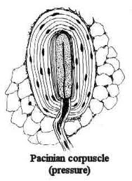
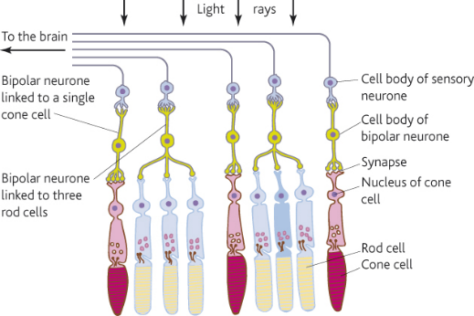
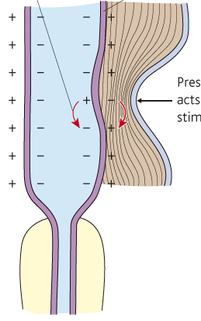
Unit 5: Chapter 9: Response to stimuli
9.4 Role of receptors:
What are the main features of sensory reception?
What is Pacinian corpuscle and how does it work?
How do receptors work together in the eye?
Key words:
Pancinian corpus, ligaments, tendons, rod cells, bipolar cells, visual acuity, generator potential, cone cells
Describe the structure and function of the Pacinian corpuscle:
Describe the structure and function of rod and cone cells in the retina:
 | Rod | Cone
Shape
Number
Distribution
Visual acuity
Sensitivity in low light conditions

Slide 6
Unit 5: Chapter 9: Response to stimuli
Exam questions
Termites are insects. Some species live in colonies in the soil. Although most termites are wingless, winged termites are sometimes produced. The winged termites fly from the soil, mate and start new colonies.
A scientist studied the behaviour of winged termites. He divided these termites into three groups.
● Group A had their eyes covered.
● Group B had their antennae removed.
● Group C was the control group.
He put individual winged termites on a sloping board that was illuminated from one side. The diagram shows the direction of movement of a typical termite from each of the three groups.
What type of behaviour was shown by the termite from group B?
(1 mark)
Give the evidence for your answer.
(1 mark)
Explain what the results from group A suggest about the factors controlling the behaviour of winged termites.
(3 marks)
Suggest one advantage to the termites from group C of the behaviour shown in the investigation.
(2 marks)
Notes:
AQA-BIOL5-Jun10 – question 1

Slide 7
Unit 5: Chapter 10: Coordination
10.1 Coordination:
How do nervous and hormonal coordination differ?
What are chemical mediators and how do they work?
What changes do plants respond to?
How do plants respond to change?
What are plant growth factors?
Key words:
nervous system, hormonal system, neurotransmitters, chemical mediators, histamine, allergen, prostaglandins, indoleacetic acid
Explain how hormonal coordination works:
Explain how nervous coordination works:
Explain the key differences between the two:
Transmission:
Response:
Effect:
State the changes plants respond to:
Describe how they respond to these changes:
Explain the role of plant growth factors, use Darwin’s, Boysen-Jensen’s, Paal’s and Brigg’s experiments in your explanation:

Slide 8
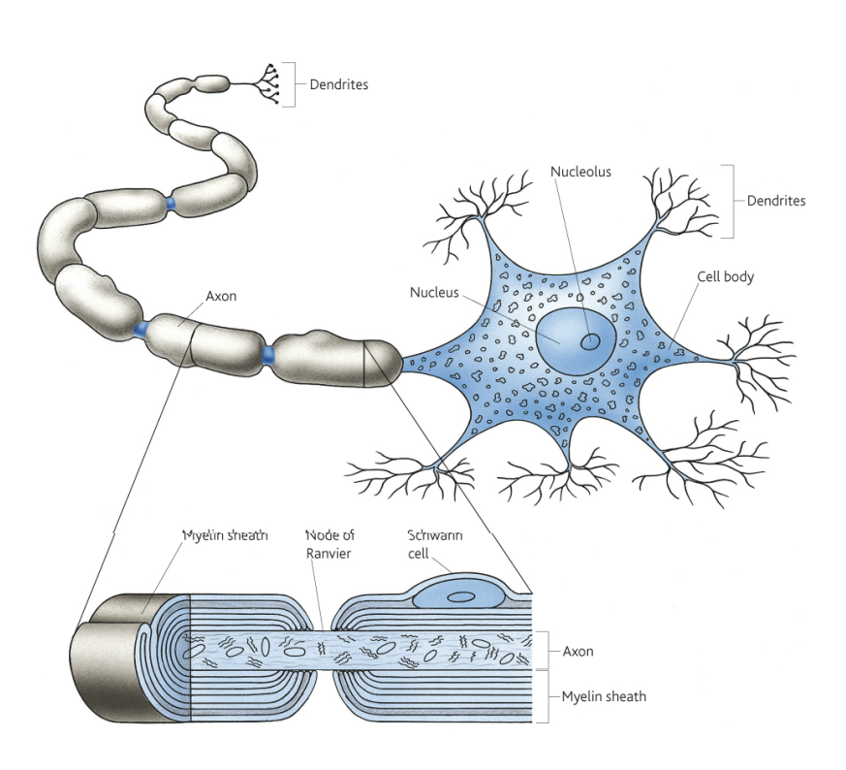
Unit 5: Chapter 10: Coordination
10.2 Neurones:
What is a neurone?
What is the structure of a myelinated motor neurone?
What are the different types of neurone?
Key words:
cell body, dendrons, axon, Schwann cells, myelin sheath, nodes of Ranvier
Describe the structure and function of the parts of a neurone:
Draw an diagram and state the function of:
Motor neurone:
Sensory neurone:
Intermediate neurone:

Slide 9
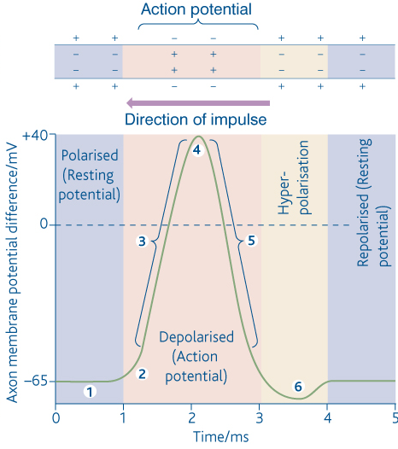
Unit 5: Chapter 10: Coordination
10.3 The nerve impulse:
What resting potential?
How is resting potential establish in a neurone?
What is an action potential?
Key words:
resting potential, action potential, phospholipid, intrinsic proteins, sodium-potassium pump, depolarisation, repolarisation
Explain what resting potential is, including the role of potassium and sodium ions in its generation:
Explain what is happening at points 1-6 on the graph:
1
4
2
5
3
6

Slide 10
Unit 5: Chapter 10: Coordination
10.4 Passage of an action potential:
How does an action potential move along an unmyelinated axon?
How does an action potential move along a myelinated axon?
Key words:
action potential, myelin, axon, repolarisation, depolarisation, polarised, node of Ranvier
Explain, using diagrams, how an action potential moves along an unmylinated axon:
Explain, using diagrams, how an action potential moves along a mylinated axon:

Slide 11
Unit 5: Chapter 10: Coordination
10.5 Speed of the nerve impulse:
What factors affect the speed of conductance of an action potential?
What is the refectory period?
What is its role in separating one impulse from the next?
What is meant by the all-or-nothing principle?
Key words:
salatory conduction, sodium-potassium pump, voltage-gated channels, refectory period,
State the factors that affect the speed of conductance of an action potential
Explain how the refectory period separated one impulse from the next and why is this important:
Explain what the refectory period is
Explain what the “all or nothing” principle is:

Slide 12
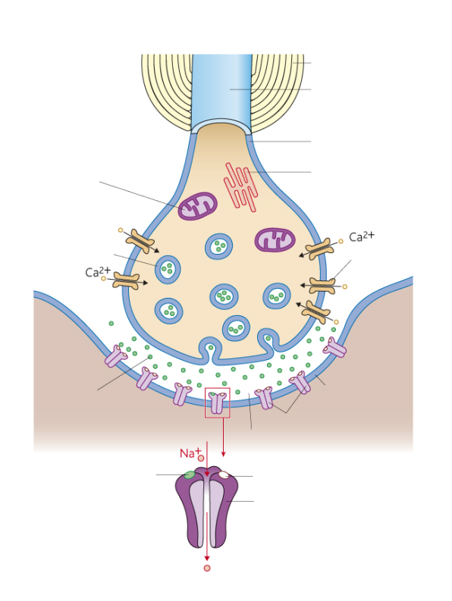
Unit 5: Chapter 10: Coordination
10.6 Structure and function of synapses:
What is a synapse?
What function do synapses perform?
Key words:
unidirectionality, temporal summation, spatial summation, inhibition
Explain the structure and function of the parts of the synapse:
Explain the following functions of a synapse:
Unidirectionality:
Summation:
Temporal summation:
Spatial summation:
Inhibition:

Slide 13
Unit 5: Chapter 10: Coordination
10.7 Transmission across a synapse:
How is information transmitted across a synapse?
Key words:
neurotransmitters
Explain the effects of drugs on how information is transmitted across a synapse:

Slide 14
Unit 5: Chapter 10: Coordination
Exam questions
During an action potential, the permeability of the cell-surface membrane of an axon changes. The graph shows changes in permeability of the membrane to sodium ions (Na+) and to potassium ions (K+) during a single action potential.
Explain the shape of the curve for sodium ions between 0.5 ms and 0.7ms.
(3 marks)
During an action potential, the membrane potential rises to +40 mV and then falls. Use information from the graph to explain the fall in membrane potential.
(3 marks)
After exercise, some ATP is used to re-establish the resting potential in axons. Explain how the resting potential is re-established..
(2 marks)
Notes:
AQA-BIOL5-Jun10 – question 3

Slide 15
Unit 5: Chapter 10: Coordination
Exam questions
Different substances are involved in coordinating responses in animals.
Hormones are different from local chemical mediators such as histamine in the cells they affect.
Describe how hormones are different in the cells they affect.
(1 mark)
Describe how hormones and local chemical mediators reach the cells they affect.
(2 marks)
2 (b) Synapses are unidirectional. Explain how acetylcholine contributes to a synapse being unidirectional.
(2 marks)
Cells in the stomach wall release gastric juice after a meal. The graph shows how the volumes of gastric juice produced by nervous stimulation and by hormonal stimulation change after a meal.
Describe the evidence from the graph that curve A represents the volume of gastric juice produced by nervous stimulation.
(2 marks)
Notes:
AQA-BIOL5-Jun11 – question 2

Slide 16
Unit 5: Chapter 10: Coordination
Exam questions
Scientists investigated the response of the roots of pea seedlings to gravity.
They took three samples of seedlings, A, B, and C, and placed them so that their roots were growing horizontally. The root tips of each sample had been given different treatments. After a set time, the scientists recorded whether the roots of the seedlings had grown upwards or downwards and the amount of curvature. The table shows the treatment they gave to each sample and their results.
The pea seedlings were kept in the dark after each treatment. Explain why this was necessary.
(1 mark)
What conclusion can be made from the results for treatment B?
(1 mark)
Suggest how indoleacetic acid (IAA) could have caused the results for
treatment A
(2 marks)
treatment C.
(2 marks)
Notes:
AQA-BIOL5-Jun12 – question 7

Slide 17
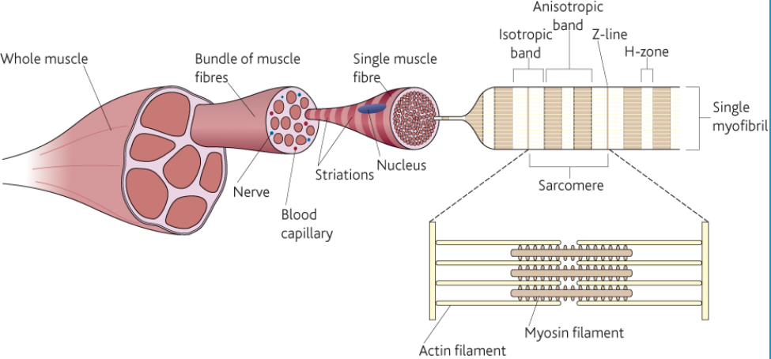
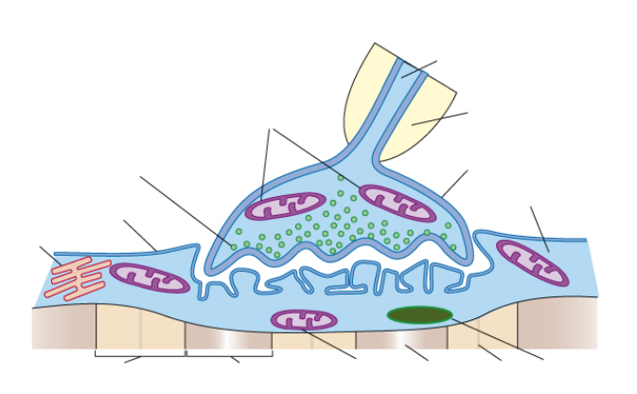
Unit 5: Chapter 11: Muscle control
11.1 Structure of skeletal muscle:
What are the gross and microscopic structure of a skeletal muscle?
What is the ultrastructure of a myofibril?
How are actin and myosin arranged within a myofibril?
Key words:
cardiac muscle, skeletal muscle, smooth muscle, actin, myosin, isotropic band, anisotropic band, H-zone, Z-zone, sarcomere, tropomyosin, troponin,
This is a diagram of the structure of a skeletal muscle:
Fill in the missing labels:
Explain the adaptations of slow-twitch fibres:
Explain the adaptations of fast-twitch fibres:
Describe the neuromuscular junction and how it is adapted to its function:
Label the features of the neuromuscular junction

Slide 18
Unit 5: Chapter 11: Muscle control
11.2 Contraction of skeletal muscle:
What evidence supports the sliding filament mechanism of muscle contraction?
How does the sliding filament mechanism cause a muscle to contract or relax?
Where does the energy for the muscle contraction come from?
Key words:
sarcomere, myosin filament, actin, tropomyosin, calcium ions, acetylchlorine, hydrolysis, ATP
Draw a diagram of the sarcomere of a relaxed muscle:
Explain the sliding filament theory of muscle contraction, you can use diagrams:
Draw a diagram of the sarcomere of a contracted muscle:
Where does the energy for the muscle contraction come from?

Slide 19
Unit 5: Chapter 11: Muscle control
Exam questions
The drawing is a tracing of a cross-section through skeletal muscle tissue.
This muscle contains fast muscle fibres and slow muscle fibres. The section has been stained to show the distribution of the enzyme succinate dehydrogenase. This enzyme is found in mitochondria.
Succinate dehydrogenase catalyses one of the reactions in the Krebs cycle. What is the evidence from the drawing that muscle fibre S is a slow muscle fibre? Explain your answer.
(2 marks)
Use evidence from the diagram to describe the distribution of mitochondria inside the slow muscle fibres. Explain the importance of this distribution.
(3 marks)
You could use an optical microscope and a slide of stained muscle tissue to find the diameter of one of the muscle fibres. Explain how.
(2 marks)
A student found the mean diameter for the slow muscle fibres in a section. Give two precautions that she should have taken when sampling the fibres. Give a reason for each precaution.
1
2
(2 marks)
Notes:
AQA-BIOL5-Jun10 – question 7

Slide 20
Unit 5: Chapter 11: Muscle control
Exam questions
The diagram shows two relaxed sarcomeres from skeletal muscle.
When the sarcomeres contract, what happens to the length of
the I-band
(1 mark)
the A-band?
(1 mark)
The length of each sarcomere in the diagram is 2.2 μm. Use this information to calculate the magnification of the diagram. Show your working.
Magnification .....................................
(2 marks)
Notes:
AQA-BIOL5-Jun12 – question 2

Slide 21
Unit 5: Chapter 12: Homeostasis
12.1 Principles of homeostasis:
What is homeostasis?
What is the importance of homeostasis?
How do control mechanisms work?
How are control mechanisms coordinated?
Key words:
homeostasis, tissue fluid, water potential, set point, feedback loop,
Explain what homeostasis is?
Input
Receptor
Control unit
Effector
Output
Changes to the system
Measures level of a factor
Operational information is stored here and used to coordinate effectors
Brings about changes to the system in order to return it to a set point
System returned to set point
Explain why homeostasis is important?
Fill in the gaps to complete the feedback loop
State some of the factors that are controlled by homeostasis?:

Slide 22
Unit 5: Chapter 12: Homeostasis
12.2 Regulation of body temperature:
What are the main ways in which heat is gained and lost in organisms?
How is body temperature regulated in ectotherms, endotherms and mammals?
Key words:
conduction, convection, radiation, kinetic energy, endotherms, ectotherms,
State the main ways in which heat is gained by organisms:
State the main ways in which heat is lost by organisms:
Complete the feedback loop for controlling body temperature in mammals:
Normal body temp
Explain how body temperature if regulated in ectotherms:
Explain how body temperature is regulated in endotherms:
Hypothalamus

Slide 23
Unit 5: Chapter 12: Homeostasis
12.3 Hormones and regulation of blood glucose:
How do hormones work?
What is the role of the pancreas in regulating blood glucose?
What factors influence blood glucose concentration?
What are the roles of insulin, glucagon and adrenaline in regulating blood glucose?
Key words: neurotransmitters, synapse, homeostasis, water potential, pancreas, α cells, β cells, glucagon, insulin,
Explain the role of the pancreas in regulating blood glucose:
State the factors that influence blood glucose concentration:
Explain the roles of the following hormones in regulating blood glucose:
Insulin:
Glucagon:
Adrenaline:
Complete the feedback loop for controlling body temperature in mammals:
To increase
To decrease
Detected by…
Detected by…
Blood glucose
Blood glucose
Response…
Response…
Normal blood glucose level
90mg100cm⁻³ blood
Blood glucose
Blood glucose

Slide 24
Unit 5: Chapter 12: Homeostasis
12.4 Diabetes and its control:
What are the two main types of diabetes and how do they differ?
How can each type of diabetes be controlled?
Key words:
Explain the two types of diabetes:
Type I:
Type II:
Explain how the two types of diabetes can be controlled:
Type I:
Type II:

Slide 25
Unit 5: Chapter 12: Homeostasis
Exam questions
Technicians in a hospital laboratory tested urine and blood samples from a girl with diabetes at intervals over a one-year period. Each time the technicians tested her urine, they also measured her blood glucose concentration. Their results are shown in the graph.
The girl who took part in this investigation was being successfully treated with insulin.
The graph shows that on some occasions, the concentration of glucose in her blood was very high. Suggest why.
(2 marks)
Use the graph to evaluate the use of the urine test as a measure of blood glucose concentration.
(3 marks)
Diabetic people who do not control their blood glucose concentration may become unconscious and go into a coma. A doctor may inject a diabetic person who is in a coma with glucagon. Explain how the glucagon would affect the person’s blood glucose concentration.
(2 marks)
Notes:
AQA-BIOL5-Jun10 – question 8

Slide 26
Unit 5: Chapter 12: Homeostasis
Exam questions
Desert iguanas are lizards that live in hot, dry conditions. Scientists measured the rate of oxygen consumption of desert iguanas at different body temperatures. Some of their results are shown in the table.
Explain how an increase in the iguana’s body temperature affects its oxygen consumption when it is at rest.
(3 marks)
7 (a) (ii) The units in the table allowed the scientists to compare the oxygen consumptions of different iguanas. Explain how.
(1 mark)
The scientists then investigated how body temperature affected the behaviour of desert iguanas. They kept the iguanas in cages. Half of each cage was in the sun and half was covered to provide shade. The scientists continuously measured the body temperature of each iguana. They also recorded the body temperature when the iguana moved between sun and shade. Their results are shown in the graph.
Describe how the movements of the iguanas between sun and shade are related to body temperature.
(1 mark)
The behaviour of the desert iguanas keeps their body temperatures within a narrow range. Explain how.
(2 marks)
At high temperatures, a desert iguana keeps its mouth wide open and breathes in and out rapidly. This is called panting. Explain how panting helps to reduce the body temperature of an iguana.
(2 marks)
Notes:
AQA-BIOL5-Jun11 – question 7

Slide 27
Unit 5: Chapter 13: Feedback mechanisms
13.1 The principles of feedback mechanisms:
What is negative feedback?
How does it help to control homeostatic processes?
How does it differ from positive feedback?
Key words:
homeostatic, hypothalamus,
Explain negative feedback:
Explain positive feedback:

Slide 28
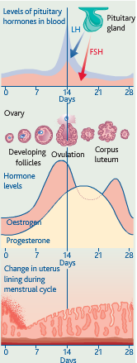
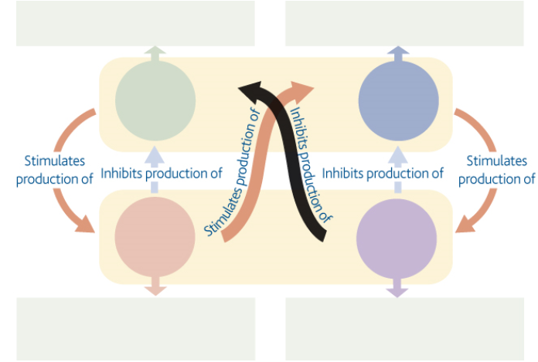
Unit 5: Chapter 13: Feedback mechanisms
13.2 Control of oestrous cycle:
Which hormones are involved in the control of oestrous cycles?
How do these hormones interact in the control of human menstrual cycle?
How are different forms of feedback loop involved in this control?
Key words: follicle-stimulating hormone (FSH), luteinising hormone (LH), oestrogen, progesterone,
State the role of each hormone:
FSH:
LH:
Oestrogen:
Progesterone:
Fill in the diagram to show how the hormones interact in the menstrual cycle:

Slide 29
Unit 5: Chapter 13: Feedback mechanisms
Exam questions
The graph shows the concentration of four hormones in a woman’s blood during one oestrous cycle.
Explain how the graph supports the following statements.
Oestrogen causes the release of LH.
(1 mark)
The woman did not become pregnant during this cycle.
(1 mark)
Implanon is a contraceptive device that is inserted under a woman’s skin and prevents pregnancy for up to three years. It is a small rod that continuously releases progesterone into her blood. This progesterone prevents fertilisation from taking place.
Explain how Implanon prevents fertilisation from taking place.
(4 marks)
Suggest one advantage of using Implanon rather than an oral contraceptive.
(1 mark)
Notes:
AQA-BIOL5-Jun12 – question 3

Slide 30
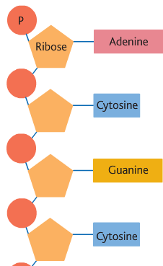
Unit 5: Chapter 14: Genetic control of protein structure and function
14.1 Structure of ribonucleic acid:
What is the genetic code and what are its main features?
What is the structure of ribonucleic acid (RNA)?
What are the structure and the role of messenger RNA (mRNA)?
What are the structure and the role of transfer RNA (tRNA)?
Key words:
messenger RNA, codon, ribonucleic acid, polymer, pentose sugar, transfer RNA, anticodon
State the features of the genetic code and give their function:
Label the structures of RNA:
Describe the structure and role of messenger RNA:
Describe the structure and role of transfer RNA:

Slide 31
Unit 5: Chapter 14: Genetic control of protein structure and function
14.2 Polypeptide synthesis – transcription and splicing:
How is pre-messenger RNA produced from DNA in the process called transcription?
How is pre-messenger RNA modified to form messenger RNA?
Key words:
nucleotides, transcription, translation, DNA replication, DNA helicase, hydrogen bonds, template strand,
Describe the process of transcription, use diagrams to help:
Describe the process splicing, use diagrams to help:

Slide 32
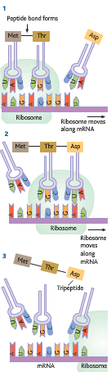
Unit 5: Chapter 14: Genetic control of protein structure and function
14.3 Polypeptide synthesis - translation:
How is polypeptide synthesised during the process of translation?
What are the roles of messenger RNA and transfer RNA in translation?
Key words:
codons, anticodons, peptide bond
Explain the process of translation in protein synthesis:

Slide 33
Unit 5: Chapter 14: Genetic control of protein structure and function
14.4 Gene mutation:
What is gene mutation?
How do deletion and substitution of bases result in different amino acid sequences in polypeptides?
Why do some mutations not result in changed amino acid sequences?
How is cell division genetically controlled?
Key words:
mutation, discontinuous variation, codons,
Explain what gene mutation is and give some of the causes of gene mutation:
Explain the process of gene mutation through substitution of bases:
Explain how cell division is genetically controlled:
Explain the process of gene mutation through deletion of bases:

Slide 34
Unit 5: Chapter 14: Genetic control of protein structure and function
Exam questions
Complete the table to show the differences between DNA, mRNA and tRNA.
(2 marks)
The diagram shows the bases on one strand of a piece of DNA.
In the space below, give the sequence of bases on the pre-mRNA transcribed from this strand.
(2 marks)
In the space below, give the sequence of bases on the mRNA produced by splicing this piece of pre-mRNA.
(1 mark)
Notes:
AQA-BIOL5-Jun10 – question 2

Slide 35
Unit 5: Chapter 14: Genetic control of protein structure and function
Exam questions
The diagram shows part of a pre-mRNA molecule.
Name the two substances that make up part X.
………...……………… and …………………………
(1 mark)
Give the sequence of bases on the DNA strand from which this pre-mRNA has been transcribed.
(1 mark)
Give one way in which the structure of an mRNA molecule is different from the structure of a tRNA molecule.
(1 mark)
Explain the difference between pre-mRNA and mRNA.
(1 mark)
The table shows the percentage of different bases in two pre-mRNA molecules.
The molecules were transcribed from the DNA in different parts of a chromosome.
Complete the table by writing the percentage of uracil (U) in the appropriate boxes.
(1 mark)
Explain why the percentages of bases from the middle part of the chromosome and the end part are different.
(2 marks)
Notes:
AQA-BIOL5-Jun11 – question 1

Slide 36
Unit 5: Chapter 14: Genetic control of protein structure and function
Exam questions
The black mamba is a poisonous snake. Its poison contains a toxin.
The table shows the base sequence of mRNA that codes for the first two amino acids of this toxin.
Complete the table to show
the base sequence of the anticodon on the first tRNA molecule that would bind to this mRNA sequence
(1 mark)
the base sequence of the DNA from which this mRNA was transcribed.
(1 mark)
The length of the section of DNA that codes for the complete toxin is longer than the mRNA used for translation. Explain why.
(1 mark)
A mutation in the base sequence of the DNA that codes for the toxin would change the base sequence of the mRNA.
Explain how a change in the base sequence of the mRNA could lead to a change in the tertiary structure of the toxin.
(1 mark)
The black mamba’s toxin kills prey by preventing their breathing. It does this by inhibiting the enzyme acetylcholinesterase at neuromuscular junctions. Explain how this prevents breathing.
(3 marks)
Notes:
AQA-BIOL5-Jun12 – question 1

Slide 37
Unit 5: Chapter 15: Control of gene expression
15.1 Totipotency and cell specialisation:
What are totipotent cells?
Which types of cells are totipotent in plants and animals?
How do cells lose their totipotency and become specialised?
How can totipotent stem cells be used to treat human disorders?
Key words:
insulin, mesophyll, xylem vessels, embryonic stem cells, clones,
Explain totipotency and cell specialisation:
Explain the growth of plant tissue cultures:
Explain the use of embryonic stem cells and the treatment of dieases:

Slide 38
Unit 5: Chapter 15: Control of gene expression
15.2 Regulation of transcription and translation:
How does oestrogen affect gene transcription?
What is small interfering RNA?
How does it affect gene expression?
Key words:
genes, insulin, transcription, phospholipid,
Explain the effect of oestrogen on gene transcription:
Explain the effect of siRNA on gene expression:

Slide 39
Unit 5: Chapter 15: Control of gene expression
Exam questions
Figure 1 shows part of a gene that is being transcribed.
Name enzyme X.
(1 mark)
Oestrogen is a hormone that affects transcription. It forms a complex with a receptor in the cytoplasm of target cells. Explain how an activated oestrogen receptor affects the target cell.
(2 marks)
Oestrogen only affects target cells. Explain why oestrogen does not affect other cells in the body.
(1 mark)
Some breast tumours are stimulated to grow by oestrogen. Tamoxifen is used to treat these breast tumours. In the liver, tamoxifen is converted into an active substance called endoxifen. Figure 2 shows a molecule of oestrogen and a molecule of endoxifen.
Use Figure 2 to suggest how endoxifen reduces the growth rate of these breast tumours.
(2 marks)
Notes:
AQA-BIOL5-Jun10 – question 5

Slide 40
Unit 5: Chapter 15: Control of gene expression
Exam questions
Transcriptional factors are important in the synthesis of particular proteins. Describe how.
(2 marks)
The flowchart shows how small interfering RNA (siRNA) affects the expression of a particular target gene.
The siRNA-protein complex attaches to an mRNA molecule coding for a particular protein (step 2). Explain what causes the siRNA to attach only to one sort of mRNA molecule.
(1 mark)
Describe and explain how expression of the target gene is affected by siRNA.
(2 marks)
Scientists have suggested that siRNA may be useful in treating some diseases. Suggest why siRNA may be useful in treating disease.
(2 marks)
Notes:
AQA-BIOL5-Jun11 – question 8

Slide 41
Unit 5: Chapter 16: DNA technology
16.1 Producing DNA fragments:
How is complementary DNA made using reverse transcriptase?
How are restrictions endonucleases used to cut DNA into fragments?
Key words:
insulin, clone, recombinant DNA, genetically modified organism, gene markers, nucleotide,
Explain how DNA fragments can be produced using reverse transcription:
Explain how DNA fragments can be produced using restriction endonuclease:

Slide 42
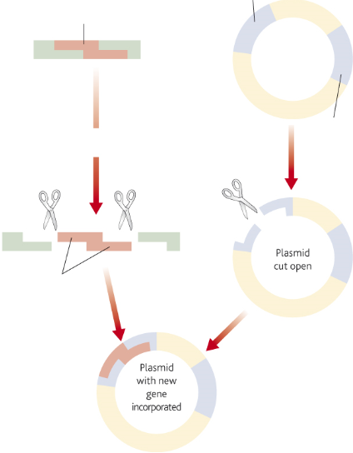
Unit 5: Chapter 16: DNA technology
16.2 In vivo gene cloning – the use of vectors:
What is the importance of ‘sticky ends’?
How can a DNA fragment be inserted into a vector?
How is the DNA of the vector introduced into host cells?
What are gene markers and how do they work?
Key words:
clone, restriction endonuclease, ‘sticky ends’, nucleotide, antibiotic-resistance, replica plating,
Explain how DNA fragments can be inserted into a vector:
Explain how DNA can be introduced into a host cell:
Explain what gene markers are and how they work:

Slide 43
Unit 5: Chapter 16: DNA technology
16.3 In vitro gene cloning – the polymerase chain reaction:
What is the polymerase chain reaction?
How does the process work?
Key words:
DNA polymerase, nucleotide, primers, thermocycler, vectors, restriction endonuclease,
Explain what the polymerase chain reaction is:
Explain the advantages of in vitro gene cloning
Explain the advantages of in vivo gene cloning

Slide 44
Unit 5: Chapter 16: DNA technology
16.4 Uses of recombinant DNA technology:
How has genetic modification of organisms benefited humans?
What roles have genetically modified microorganisms, plant and animals played in the beneficial use of recombinant DNA technology?
Key words: selective breeding, alleles, antibody, antigen, gene therapy, pathogen, human genome project
Explain what genetic modification is:
Give some examples of how animals have been genetically modified:
Give some examples of how microorganisms have been genetically modified:
Give some examples of how plants have been genetically modified:

Slide 45
Unit 5: Chapter 16: DNA technology
16.5 Gene therapy:
What is cystic fibrosis?
What is the cause of cystic fibrosis?
How can gene therapy be used in the treatment of cystic fibrosis?
What is the difference between germ-line and somatic-cell gene therapy?
Key words:
Cystic fibrosis, recessive allele, mutation, osmosis, stem cells, immunodeficiency,
Explain what cystic fibrosis is:
Explain how gene therapy can be used to treat severe combined immunodeficiency:
Explain how gene therapy is used to treat CF:

Slide 46
Unit 5: Chapter 16: DNA technology
16.6 Locating and sequencing genes:
How are DNA probes and DNA hybridisation used to locate specific genes?
How can the exact order of nucleotides on a strand of DNA be determined?
What is restriction mapping and how does it help to determine the sequence of nucleotides in a gene?
Key words:
gene mutation, radioactively labelled probes, nucleotides, isotope, fluorescently labelled probes, DNS hybridisation, gel electrophoresis, restriction endonuclease, recognition sites,
Explain how DNA probes work:
Explain what DNA sequencing is:
Explain what restriction mapping is:

Slide 47
Unit 5: Chapter 16: DNA technology
16.7 Screening for clinically important genes:
How can DNA probes be used to screen patients for gene mutations?
What role does genetic counselling play in the process?
Key words: gene mutation, nucleotides, dominant alleles, recessive, homozygous, heterozygous, tumour suppressor genes, mutagens, co-dominant, genotypes, phenotypes
Explain how genetic screening works:
Explain the role genetic counselling plays in genetic screening:

Slide 48
Unit 5: Chapter 16: DNA technology
16.8 Genetic fingerprinting:
What is genetic fingerprinting ?
How is genetic fingerprinting carried out?
How are the results interpreted?
For what purposes is it used?
Key words:
genetic fingerprinting, introns, extraction, digestion, restriction endonuclease, separation, gel electrophoresis, hybridisation, development,
Explain the process of DNA fingerprinting:
Extraction:
Digestion:
Separation:
Hybridisation:
Development:
Explain how you would interpret the results of DNA fingerprinting:
Explain some of the uses of DNA fingerprinting:

Slide 49
Unit 5: Chapter 16: DNA technology
Exam questions
There are wolves in many European countries. Scientists investigated the genetic diversity of these wolves. They collected samples of DNA from the mitochondria of
wolves from different countries. For each sample they identified which haplotypes were present in the DNA. A haplotype is a particular sequence of bases on DNA. Mutations can produce new haplotypes.
The scientists wanted to find out whether one of the haplotypes in the Portuguese wolves was the same as one of those in the Spanish wolves. They used a restriction endonuclease, electrophoresis and a labelled DNA probe.
For what purpose did they use
the restriction endonuclease
(1 mark)
9 (a) (ii) electrophoresis?
(1 mark)
Explain why the labelled DNA probe could be used to find out whether the haplotypes were the same.
(2 marks)
Two hundred years ago there were many wolves in Italy. By the 1970s there were fewer than 100 wolves left. Since 1980, wolves have increased in number and have spread to France.
Use this information to explain the number of haplotypes in the Italian wolves.
(2 marks)
Suggest an explanation for the number of haplotypes in the wolves that have spread to France.
(1 mark)
The scientists analysed the DNA on the Y chromosome and the DNA in the mitochondria of the Swedish wolves. They concluded that the Swedish wolf population descended from one male wolf from Finland and one female wolf from Russia.
Explain why DNA on the Y chromosome helped them to reach this conclusion.
(1 mark)
Suggest why DNA in the mitochondria helped them to reach this conclusion.
(1 mark)
Notes:
AQA-BIOL5-Jun10 – question 9

Slide 50
Unit 5: Chapter 16: DNA technology
Exam questions
Wolves eat different mammals. An ecologist investigated factors that affect wolf numbers in North America. He collected data from different field studies carried out in different places. The graph shows his results.
The wolf numbers are given per unit area. Explain why.
(2 marks)
The ecologist calculated the total prey index for each of the places that had been studied. In order to do this, he gave each prey species a value based on how much food was available to wolves from the prey animal concerned. He called this value the prey index.
The ecologist considered that the prey index gave a better idea of the food available than the prey biomass in kg. Suggest why the prey index gives a better idea of food available.
(2 marks)
The ecologist calculated the total prey index by combining the prey indices and the total number of animals of each species present in 1000km2. He plotted this information on the graph.
What does the graph suggest about the factors that determine wolf numbers in North America? Explain your answer.
(2 marks)
Notes:
AQA-BIOL5-Jun10 – question 9

Slide 51
Unit 5: Chapter 16: DNA technology
Exam questions
Scientists used restriction mapping to investigate some aspects of the base sequence of an unknown piece of DNA. This piece of DNA was 3 000 base pairs (bp) long.
The scientists took plasmids that had one restriction site for the enzyme Kpn1 and one restriction site for the enzyme BamH1. They inserted copies of the unknown piece of DNA into the plasmids. This produced recombinant plasmids.
The diagram shows a recombinant plasmid.
When the scientists digested one of the recombinant plasmids with Kpn1, they obtained two fragments. One fragment was measured as 1 000 bp. The other fragment was described as "very large". What does this show about the base sequence of the unknown piece of DNA?
(2 marks)
One of the fragments that the scientists obtained was described as "very large". What is represented by this very large fragment?
(1 mark)
When the scientists digested another of the recombinant plasmids with BamH1, they obtained three fragments.
How many BamH1 restriction sites are there in the unknown piece of DNA?
(1 mark)
Scientists can separate fragments of DNA using electrophoresis. Suggest how they can use electrophoresis to estimate the number of base pairs in the separated fragments.
(2 marks)
Scientists need to take precautions when they carry out restriction mapping. They need to make sure that the enzyme they have used has completely digested the DNA.
One check they may carry out is to add the sizes of the fragments together. How could scientists use this information to show that the DNA has not been completely digested? Explain your answer.
(2 marks)
Notes:
AQA-BIOL5-Jun11 – question 5

Slide 52
Unit 5: Chapter 16: DNA technology
Exam questions
Huntington’s disease is a genetic condition that leads to a loss in brain function. The gene involved contains a section of DNA with many repeats of the base sequence CAG. The number of these repeats determines whether or not an allele of this gene will cause Huntington’s disease.
An allele with 40 or more CAG repeats will cause Huntington’s disease.
An allele with 36 – 39 CAG repeats may cause Huntington’s disease.
An allele with fewer than 36 CAG repeats will not cause Huntington’s disease.
The graph shows the age at which a sample of patients with Huntington’s disease first developed symptoms and the number of CAG repeats in the allele causing Huntington’s disease in each patient.
People can be tested to see whether they have an allele for this gene with more than 36 CAG repeats. Some doctors suggest that the results can be used to predict the age at which someone will develop Huntington’s disease.
Use information in the graph to evaluate this suggestion.
(3 marks)
8 (a) (ii) Huntington’s disease is always fatal. Despite this, the allele is passed on in human populations. Use information in the graph to suggest why.
(2 marks)
Notes:
AQA-BIOL5-Jun12 – question 8

Slide 53
Unit 5: Chapter 16: DNA technology
Exam questions
Scientists took DNA samples from three people, J, K and L. They used the polymerase chain reaction (PCR) to produce many copies of the piece of DNA containing the CAG repeats obtained from each person. They separated the DNA fragments by gel electrophoresis. A radioactively labelled probe was then used to detect the fragments. The diagram shows the appearance of part of the gel after an X-ray was taken. The bands show the DNA fragments that contain the CAG repeats.
Only one of these people tested positive for Huntington’s disease. Which person was this? Explain your answer.
Person
Explanation
(2 marks)
The diagram only shows part of the gel. Suggest how the scientists found the number of CAG repeats in the bands shown on the gel.
(1 mark)
Two bands are usually seen for each person tested. Suggest why only one band was seen for Person L.
(1 mark)
Notes:
AQA-BIOL5-Jun12 – question 8

Slide 54
More exam questions
June 2010
Question 1 – Chapter 9
Question 2 – Chapter 14
Question 3 – Chapter 10
Question 4 – Chapter 13
Question 5 – Chapter 15
Question 6 – Chapter 16
Question 7 – Chapter 11
Question 8 – Chapter 12
Question 9 – Chapter 16
Question 10 – Synoptic essay question
June 2012
Question 1 – Chapter 14
Question 2 – Chapter 11
Question 3 – Chapter 13
Question 4 – Chapter 9
Question 5 – Chapter 16
Question 6 – Chapter 12
Question 7 – Chapter 10
Question 8 – Chapter 16
Question 9 – Chapter 12
Question 10 – Synoptic essay question
June 2011
Question 1 – Chapter 14
Question 2 – Chapter 10
Question 3 – Chapter 10
Question 4 – Chapter 13
Question 5 – Chapter 16
Question 6 – Chapter 10
Question 7 – Chapter 12
Question 8 – Chapter 15
Question 9 – Chapter 14
Question 10 – Synoptic essay question

